Slide 1
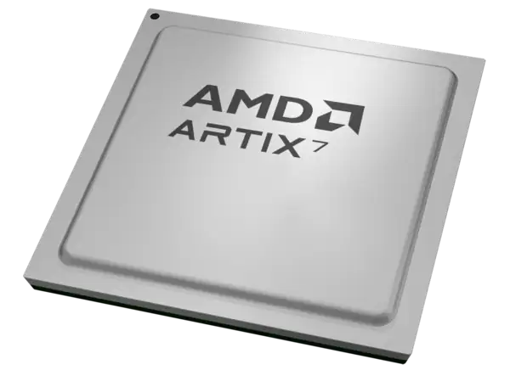
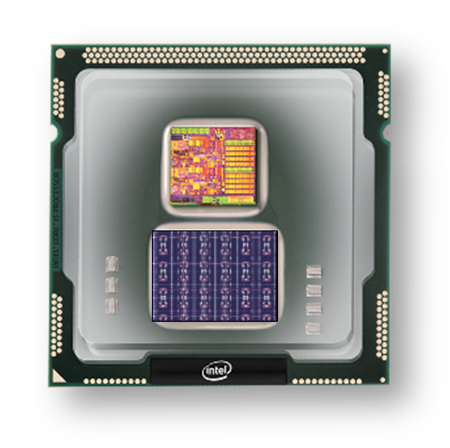
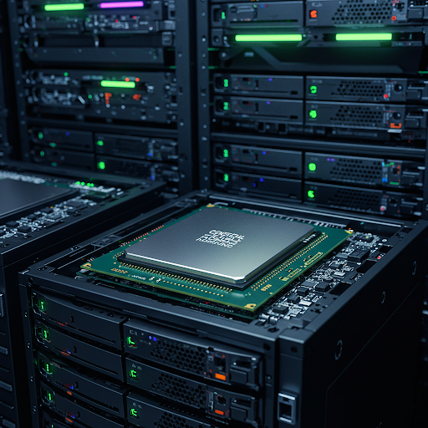
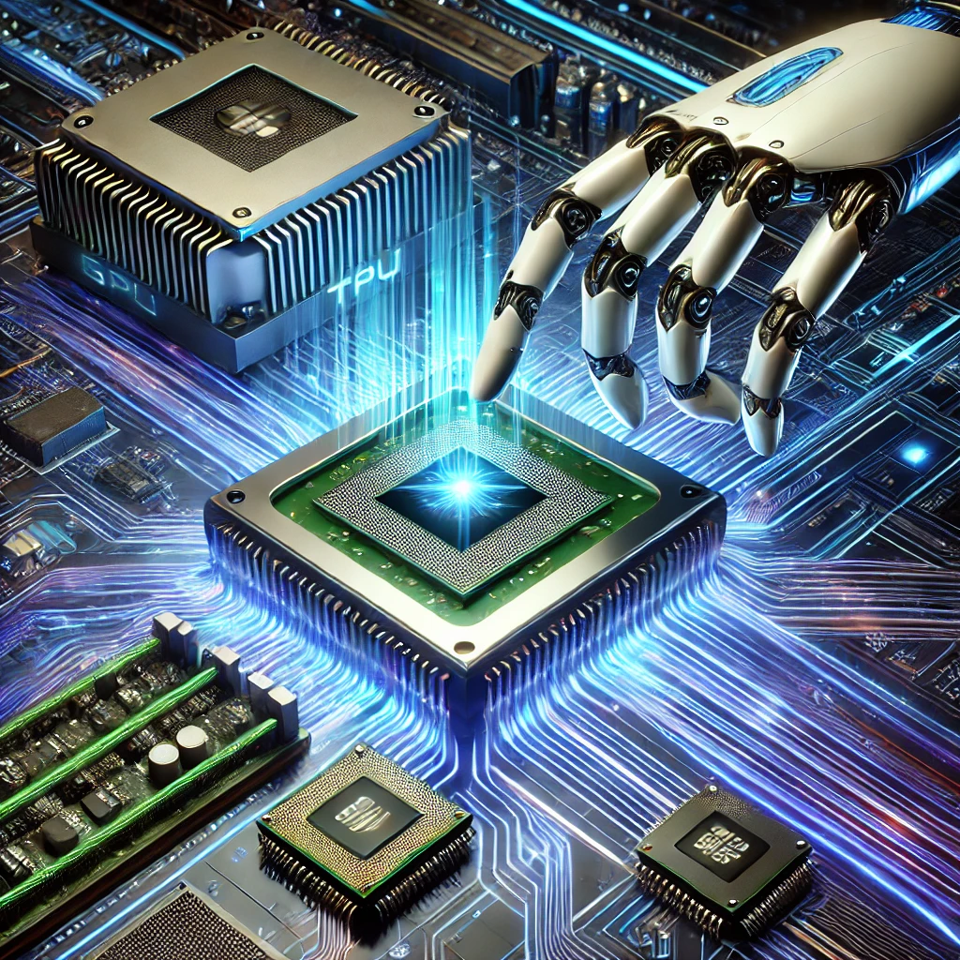
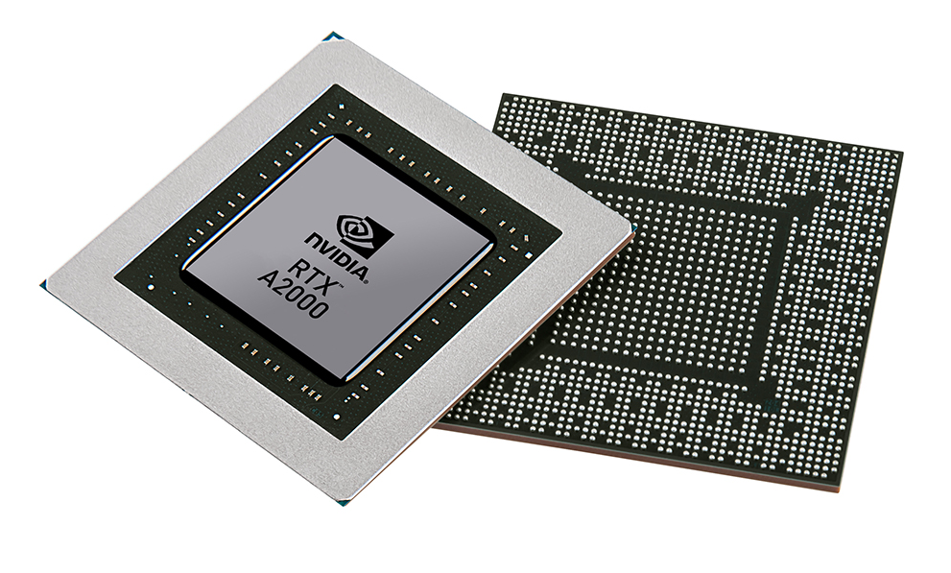


Christof Teuscher
ECE 410/510: Hardware for AI and ML
Neuromorphic chips
Portland State University
Department of Electrical and Computer Engineering (ECE)
www.teuscher-lab.com
teuscher@pdx.edu

Slide 2
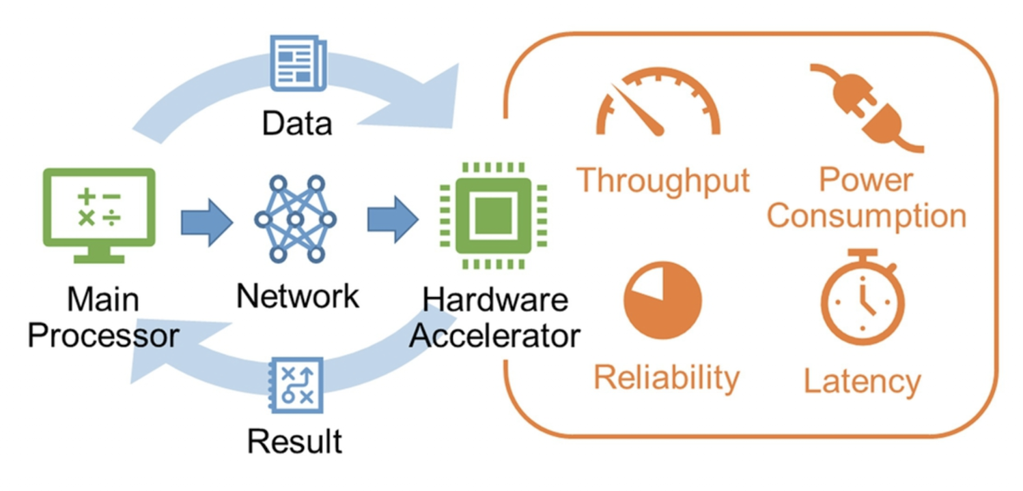
How can we accelerate an algorithm?
Or in other words: solve a problem as fast as possible?

Slide 3
How can we accelerate an algorithm?
Technology scaling (but Moore’s law is flattening out)
Cache optimizations
Code optimization
Exploiting parallelism
GPUs
TPUs
Fancier CPUs? More pipelining? Faster storage? Better networking?
HW/SW co-design
Improve the algorithm (trade time for space, approximations, etc.)
Emerging technology

Slide 4
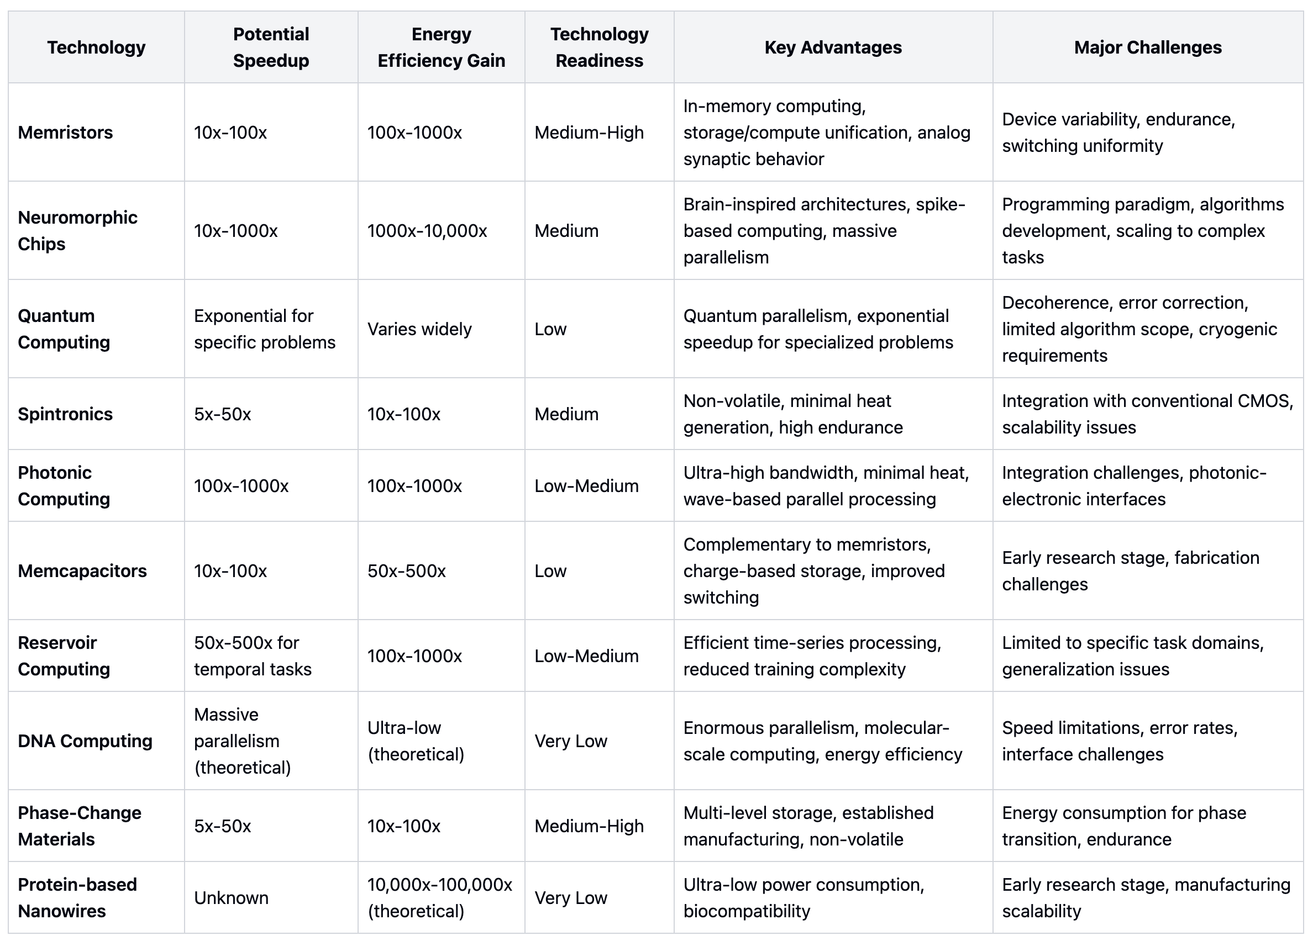
Emerging technology

Slide 5
Non-von Neuman architectures
In-memory computation (IMC or PiM)

Slide 6
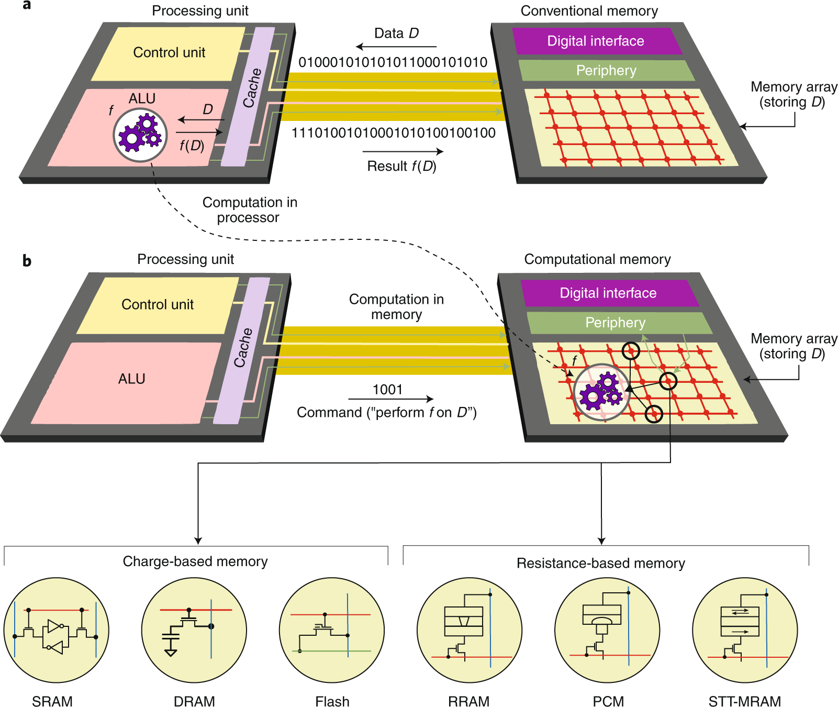
In-memory computing:
the basic idea is simple
Sebastian et al., Nature

Slide 7
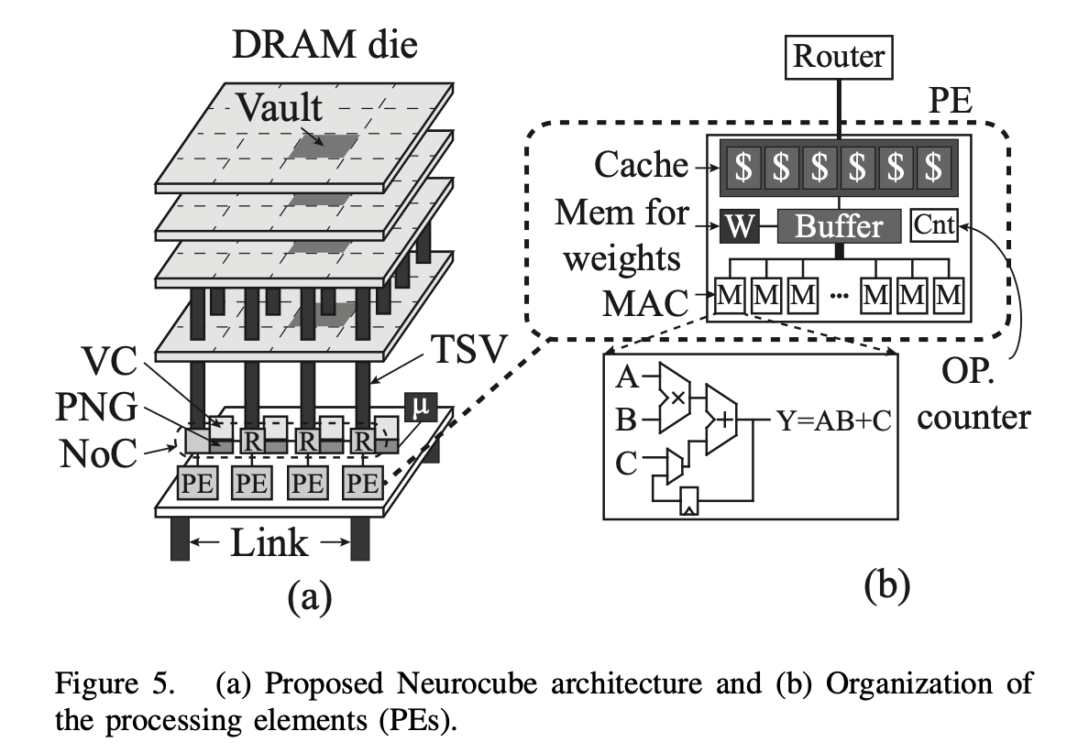
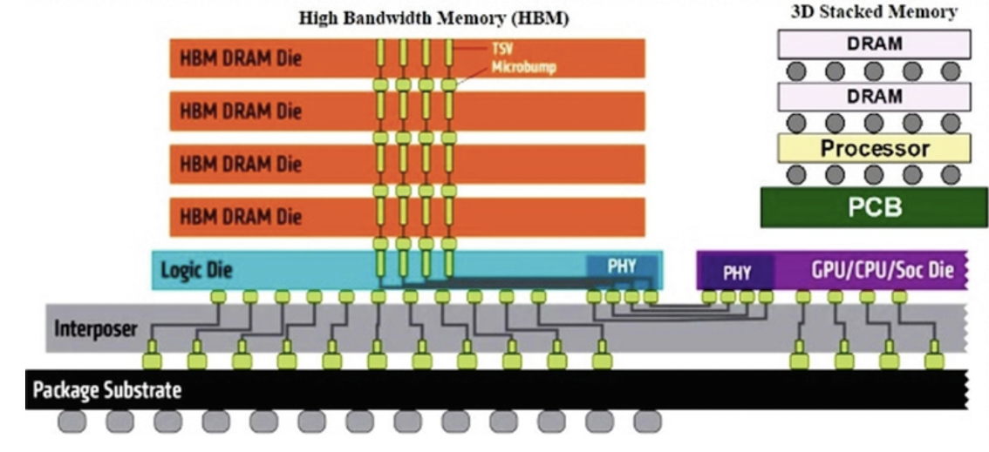
Stacked 3D chips
Mishra et al.
Kim et al., Neurocube

Slide 8
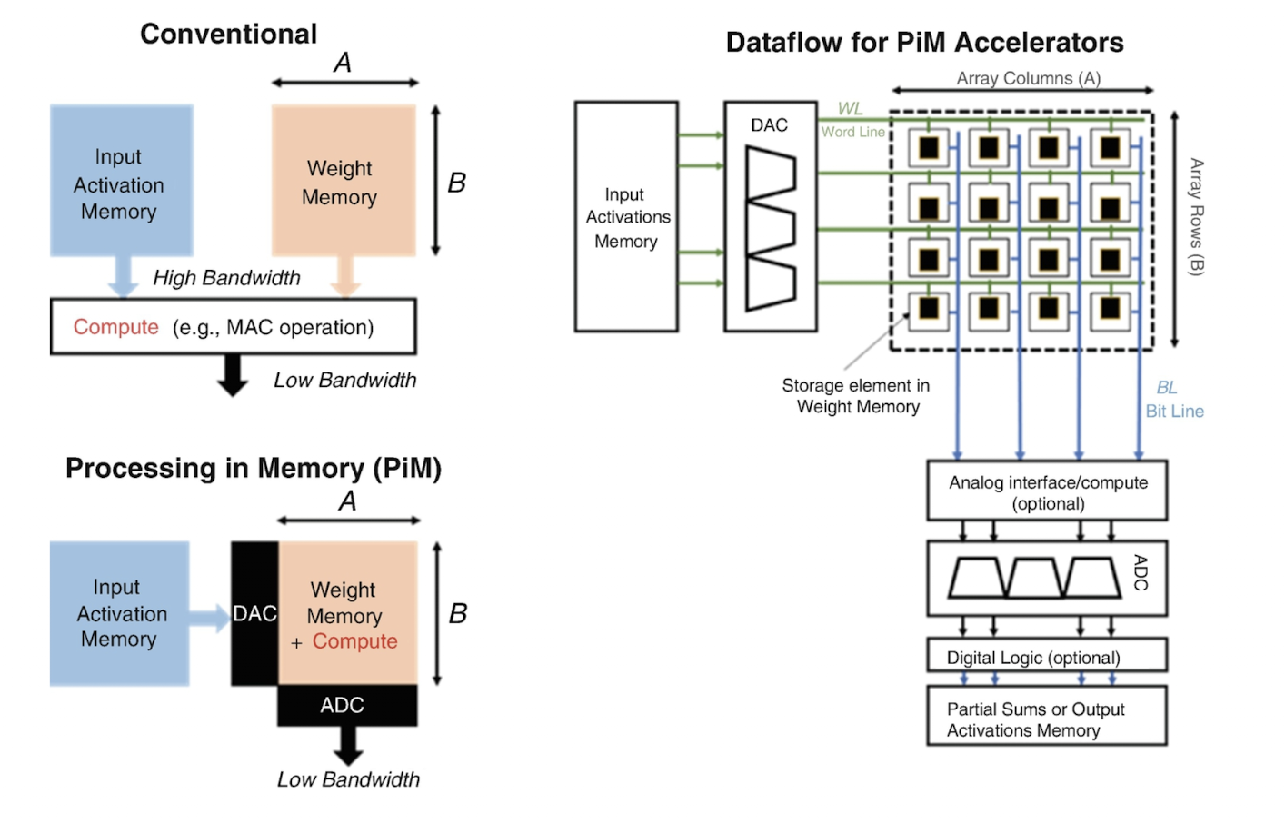
Conventional vs Processing-in-Memory (PiM)
Mishra et al.

Slide 9
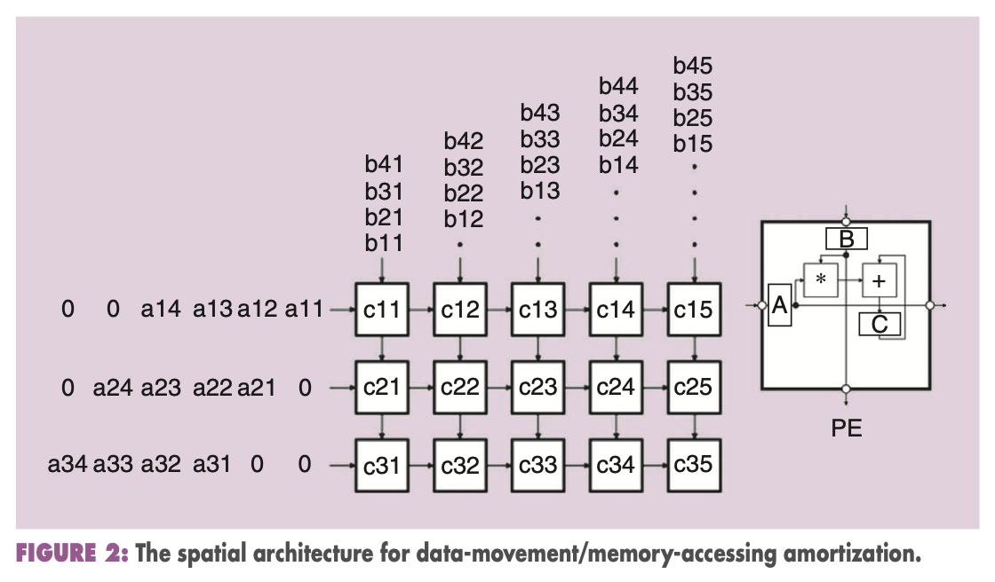
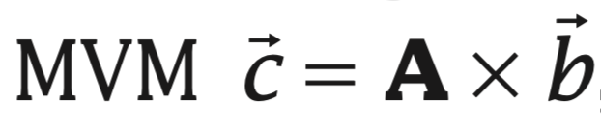
Matrix-vector multiplication (MCM)
Verma et al., In-Memory Computing, 2019

Slide 10
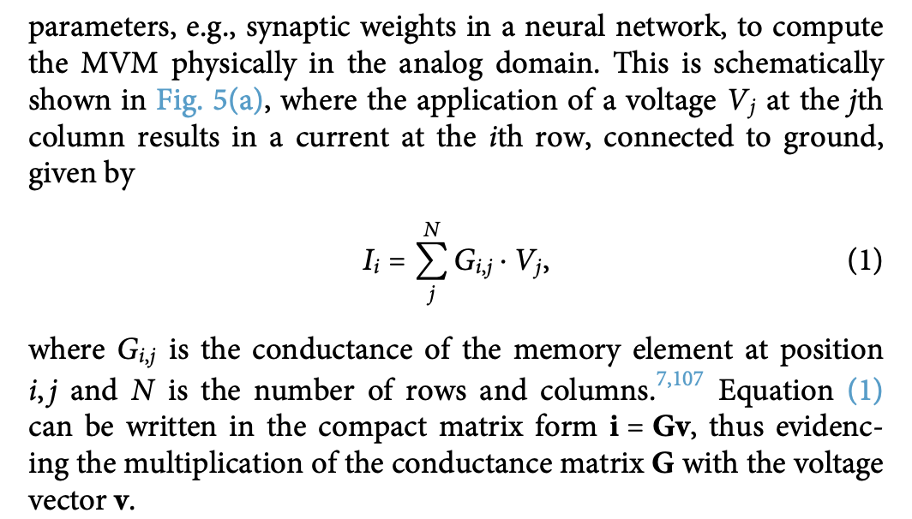
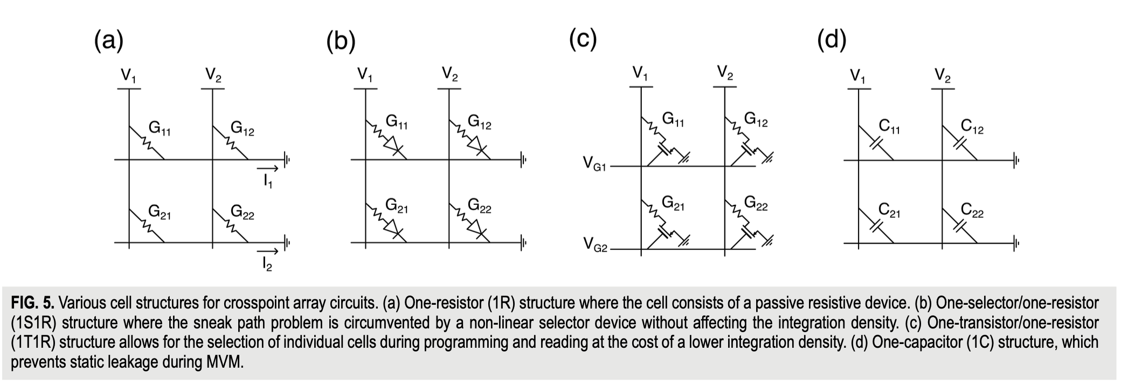
MVM (Matrix-Vector Multiplication) can be executed in a crosspoint memory array by universal circuit laws, such as Kirchhoff’s current law for summation and Ohm’s law for multiplication.
crosspoint array or
crossbar
Mannocci et al.

Slide 11
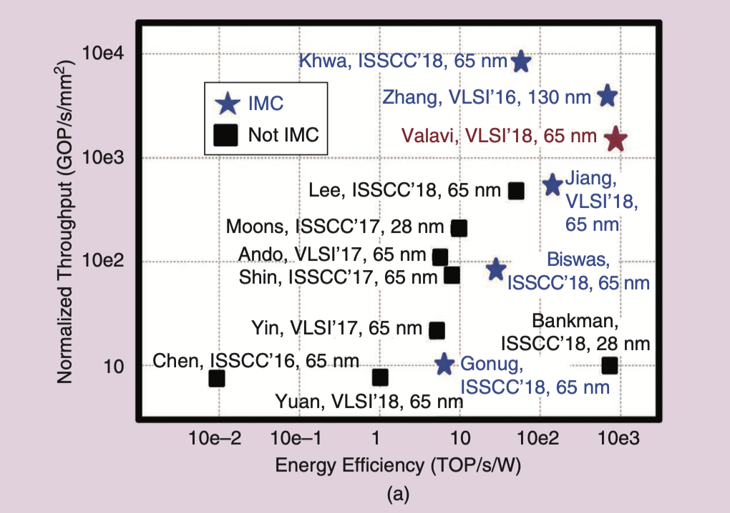
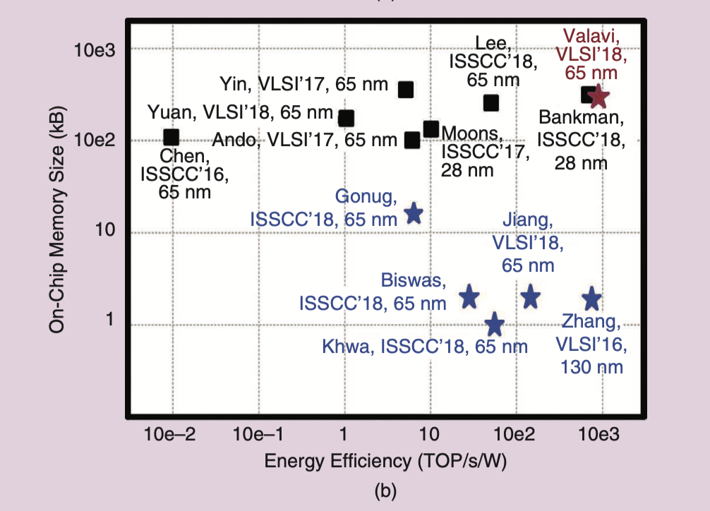
IMC vs non-IMC comparison
IMC enables ~ 10x gains in each metric.
Verma et al., In-Memory Computing, 2019

Slide 12
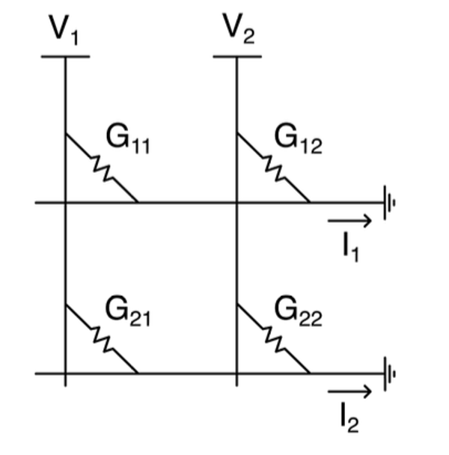
How can we man a NN onto a crossbar?

Slide 13
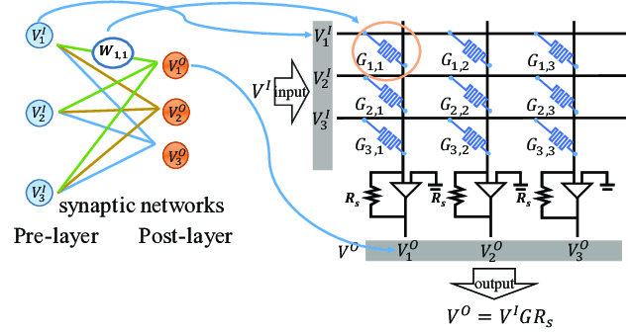
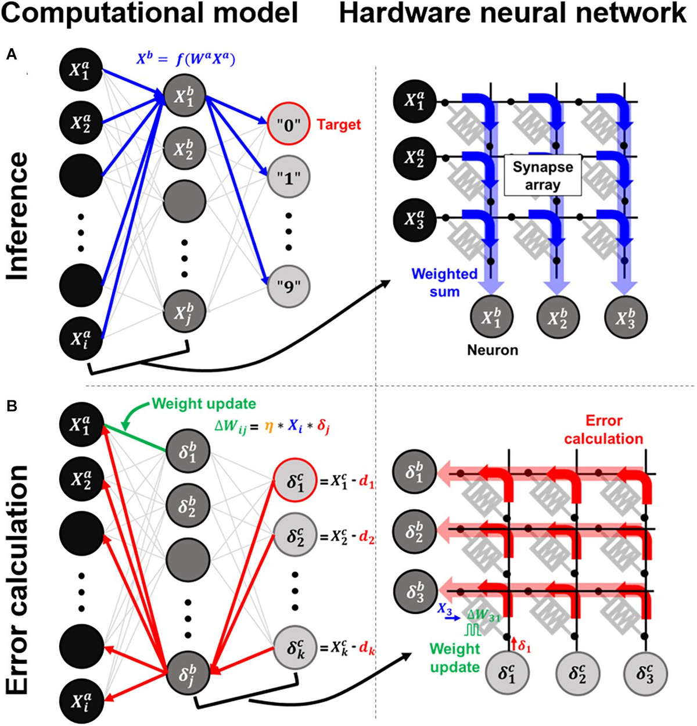
How can we map a NN onto a crossbar?
DOI: 10.1109/ACCESS.2019.2944417
Parallel multiplication: When voltage is applied to the rows, the current flowing through each memristive junction is proportional to the product of the input voltage and the junction's conductance. This effectively performs multiplication at each intersection point simultaneously.
Current summation: The currents from all intersections in a column are naturally summed according to Kirchhoff's current law, effectively adding up all the partial products.
https://doi.org/10.3389/fnins.2021.690418

Slide 14
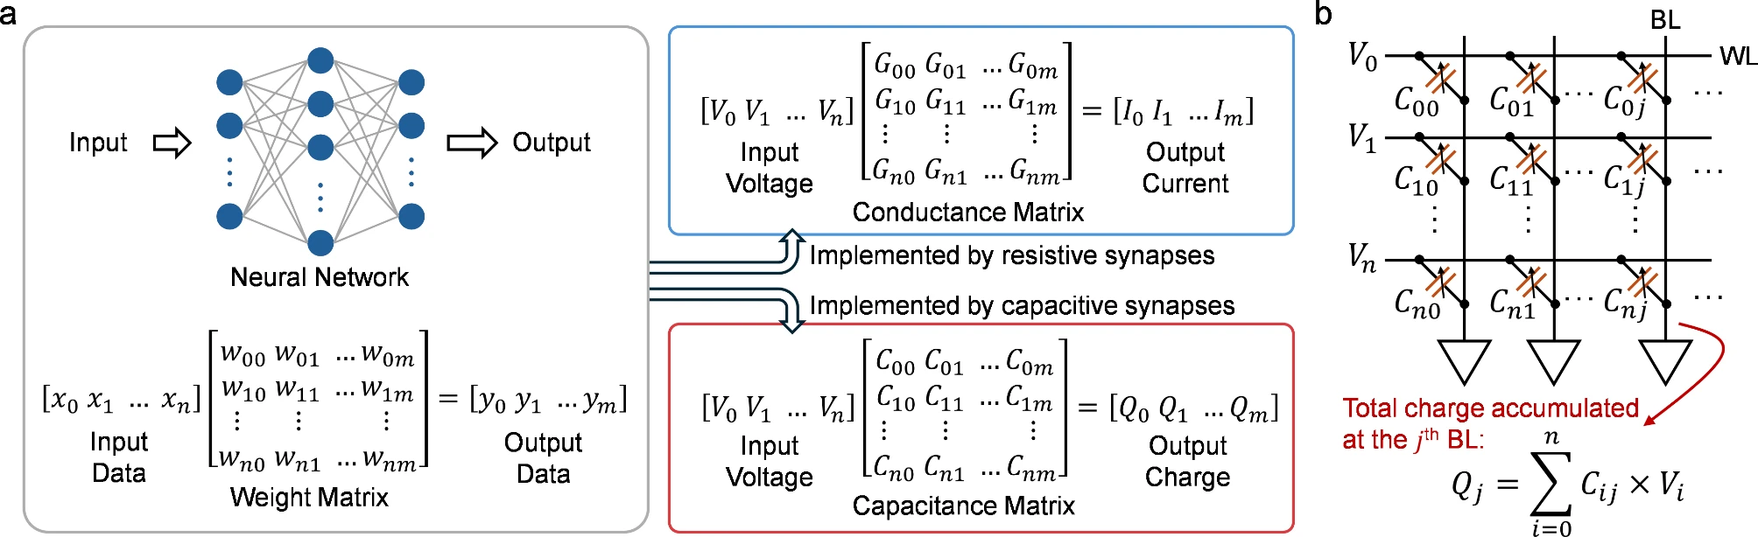
How can we map a NN onto a crossbar?
https://nanoconvergencejournal.springeropen.com/articles/10.1186/s40580-024-00463-0

Slide 15
Sneak paths (1)

Slide 16
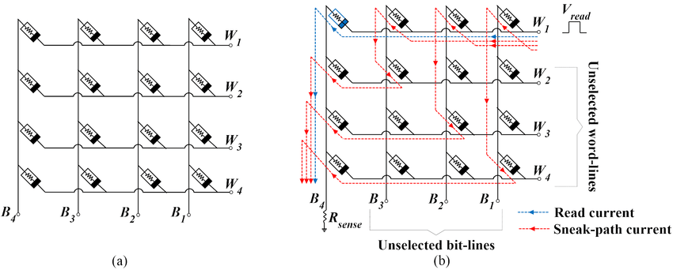
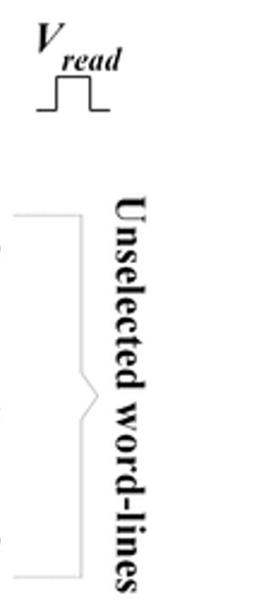
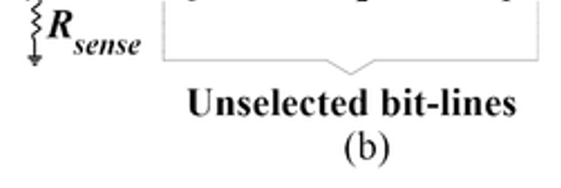
Sneak paths (2)
Make a drawing of where the current flows

Slide 17
Sneak paths (3)

Slide 18
Sneak paths (4)
Sneak-paths in crossbars are unintended current pathways that occur in memory array architectures.
Solutions: diodes or 1T1R structures

Slide 19
Questions
What is the primary advantage of in-memory computing.
In a typical crossbar implementation of a neural network, where are the synaptic weights physically represented?
What are the benefits of spiking neural nets over analog neural nets?

Slide 20
Neuromorphic chips

Slide 21
What are neuromorphic chips?
Neuromorphic chips are specialized hardware designed to mimic the structure and function of the human brain.
What neuromorphic HW would you build?
What are characteristics one would like to see in such HW?
Compute? Communication? Memory?
Do we need neuromorphic HW at all? If so, for what?
Why not do everything in software?

Slide 22
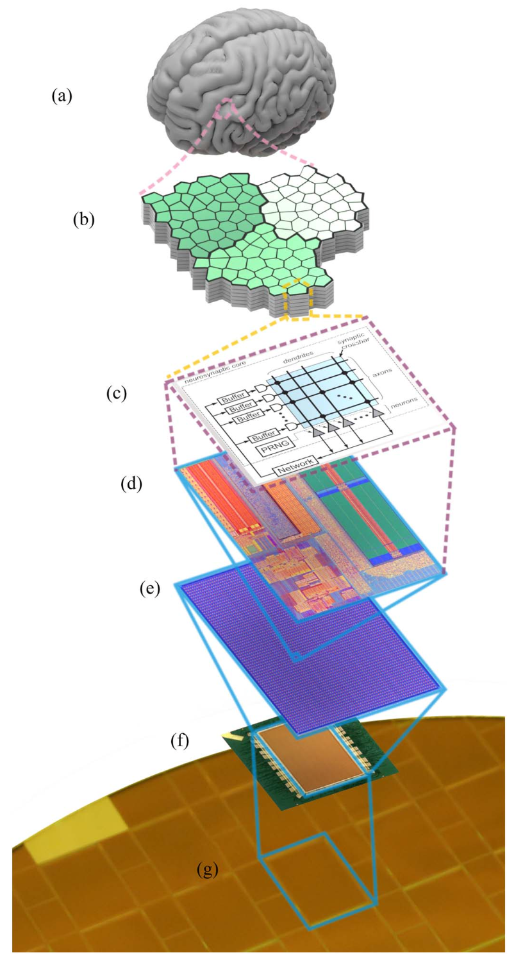
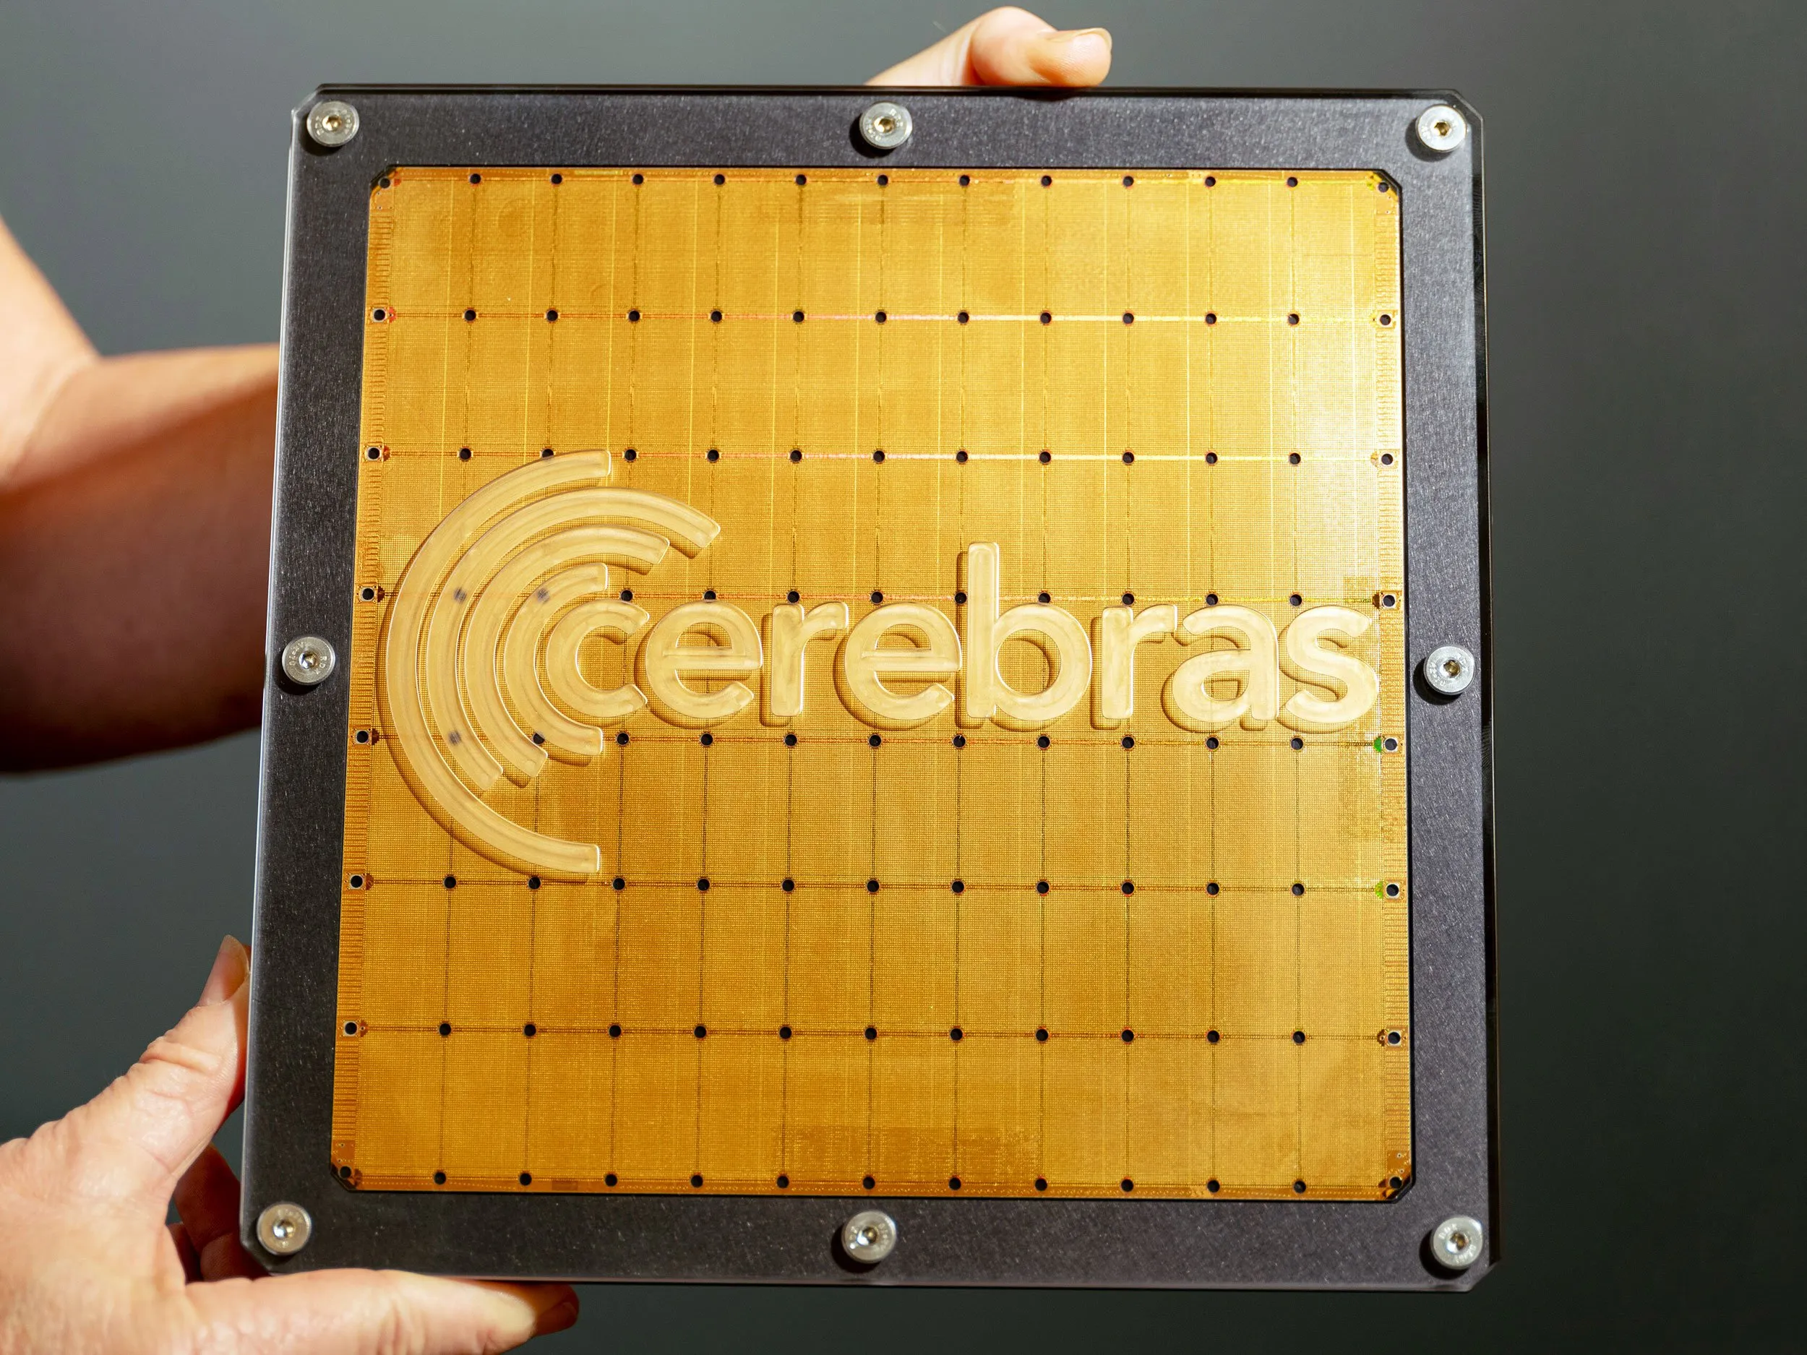
What are neuromorphic chips?
Neuromorphic chips are specialized hardware designed to mimic the structure and function of the human brain. Unlike traditional computing architectures, these chips are built to process information in ways similar to biological neural networks.
Cerebras WSE-3
300-millimeter wafer
4 trillion transistors
TSMC 5nm
57x larger than an NVIDIA H100
Accelerate AI workloads, particularly training and inference of large language models.
Not considered a neuromorphic chip

Slide 23
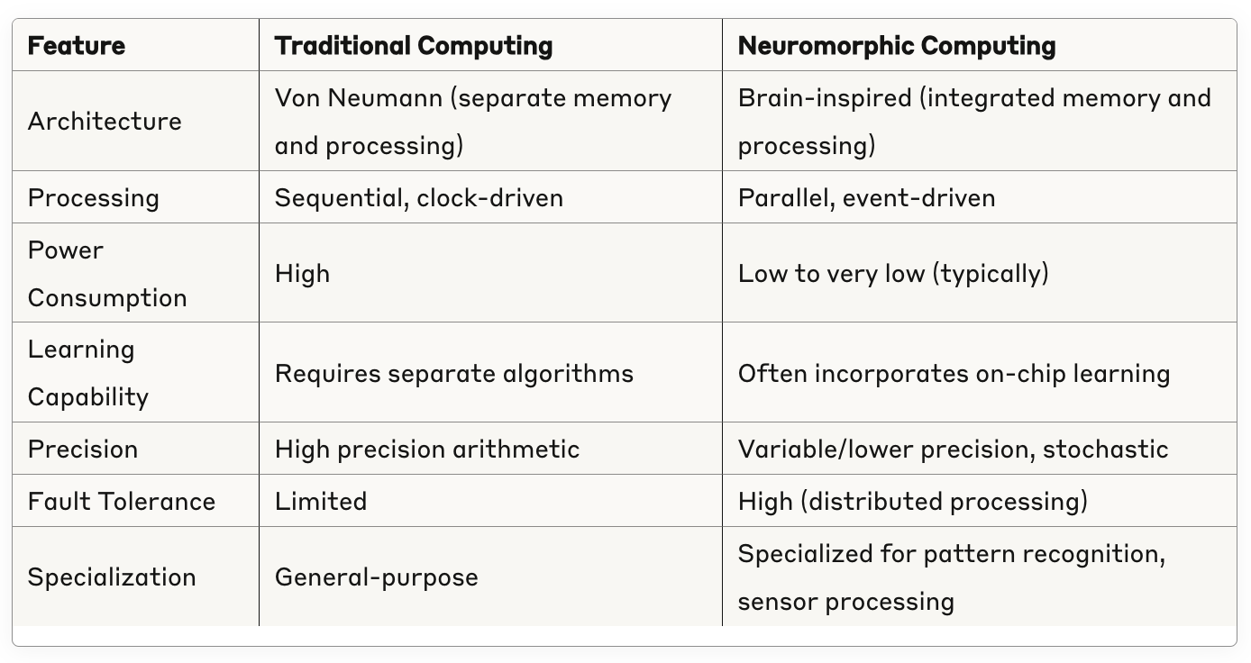
Key characteristics of all neuromorphic chips
Parallel processing - Unlike traditional Von Neumann computing where processing and memory are separate, neuromorphic chips integrate computation and memory in the same physical structures (similar to how brain cells work).
Event-driven computation - Most neuromorphic chips operate based on events or "spikes" rather than continuous clock cycles, making them more energy-efficient by only consuming power when processing information.
Adaptability - Many neuromorphic designs incorporate on-chip learning mechanisms that allow synaptic connections to strengthen or weaken based on activity patterns.
Distributed memory - Information is stored across the network in the connection strengths between neurons, rather than in a centralized memory unit.

Slide 24
What are the different approaches?
Implement neurons directly in silicon (Loihi, TrueNorth, etc.)
Simulate neurons with specialized processors (SpiNNaker).
Analog
Digital
Mixed-signal
What is a key building block for directly implementing neurons on silicon in many modern neuromorphic chips?
Can you draw a generic architecture diagram of a neuromorphic chip?

Slide 25
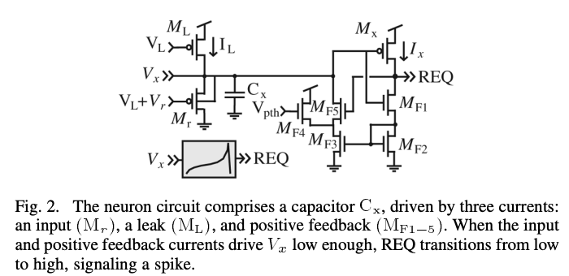
The usual trade-offs…!
Why not do everything in software?
Akida
Loihi
Loihi/2
BrainScaleS/2
SpiNNaker
IBM’s TrueNorth
IBM’s NorthPole
Flexibility
Performance
More digital circuits
Other trade-offs:
Power
Reliability
Programmability
On-chip learning
Cost
Scalability
More analog circuits
But:
Digital backend needed
DAC/ADC
LIF neuron
DOI: 10.1109/TCSI.2010.2089556

Slide 26
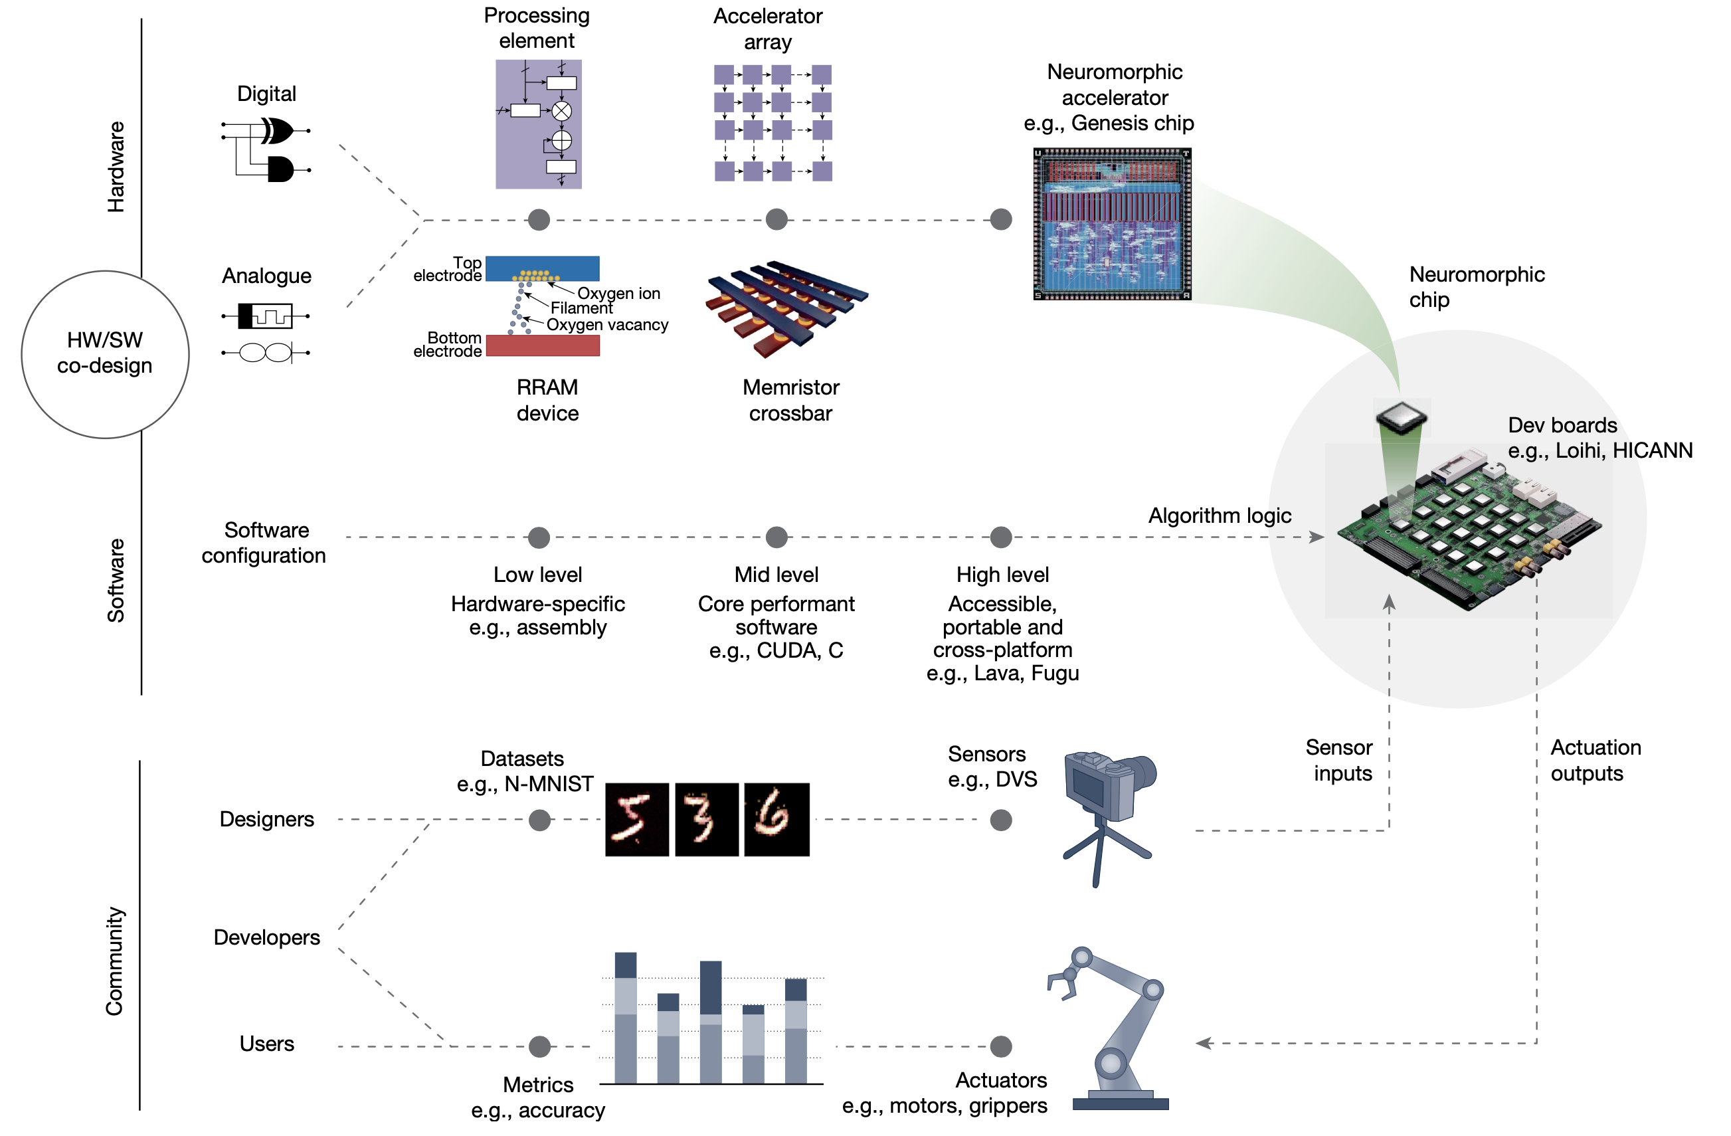
Neuromorphic computing ecosystem
https://doi.org/10.1038/s41586-024-08253-8

Slide 27
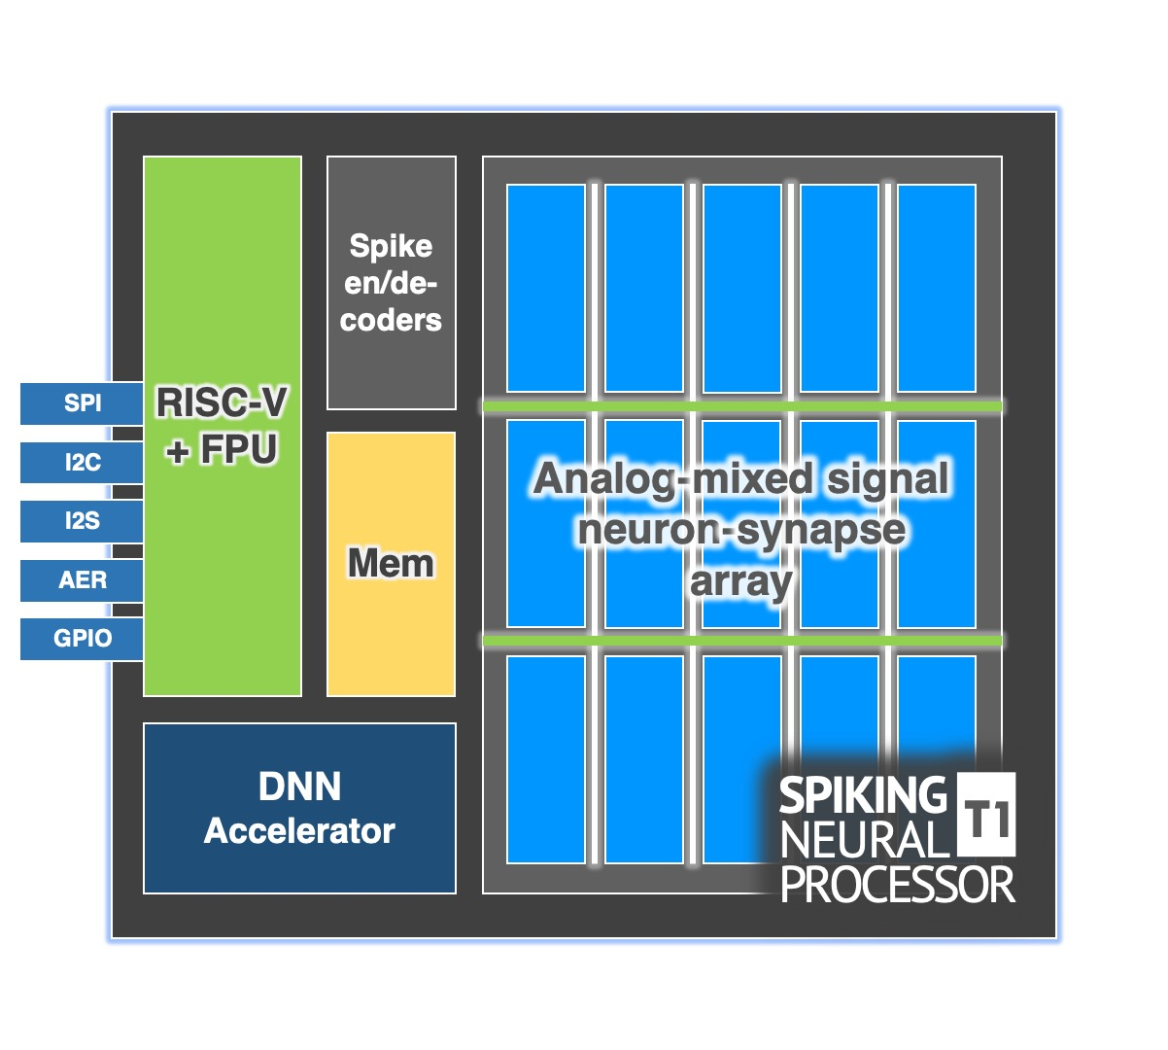
Key building block: the crossbar
Crossbar arrays provide the critical architecture for efficiently implementing synaptic connections between neurons.
Why?
Efficient matrix-vector multiplication
In-memory computing
Implementation of synaptic weights
Parallel processing
Integration with emerging technologies
Generic diagram?

Slide 28
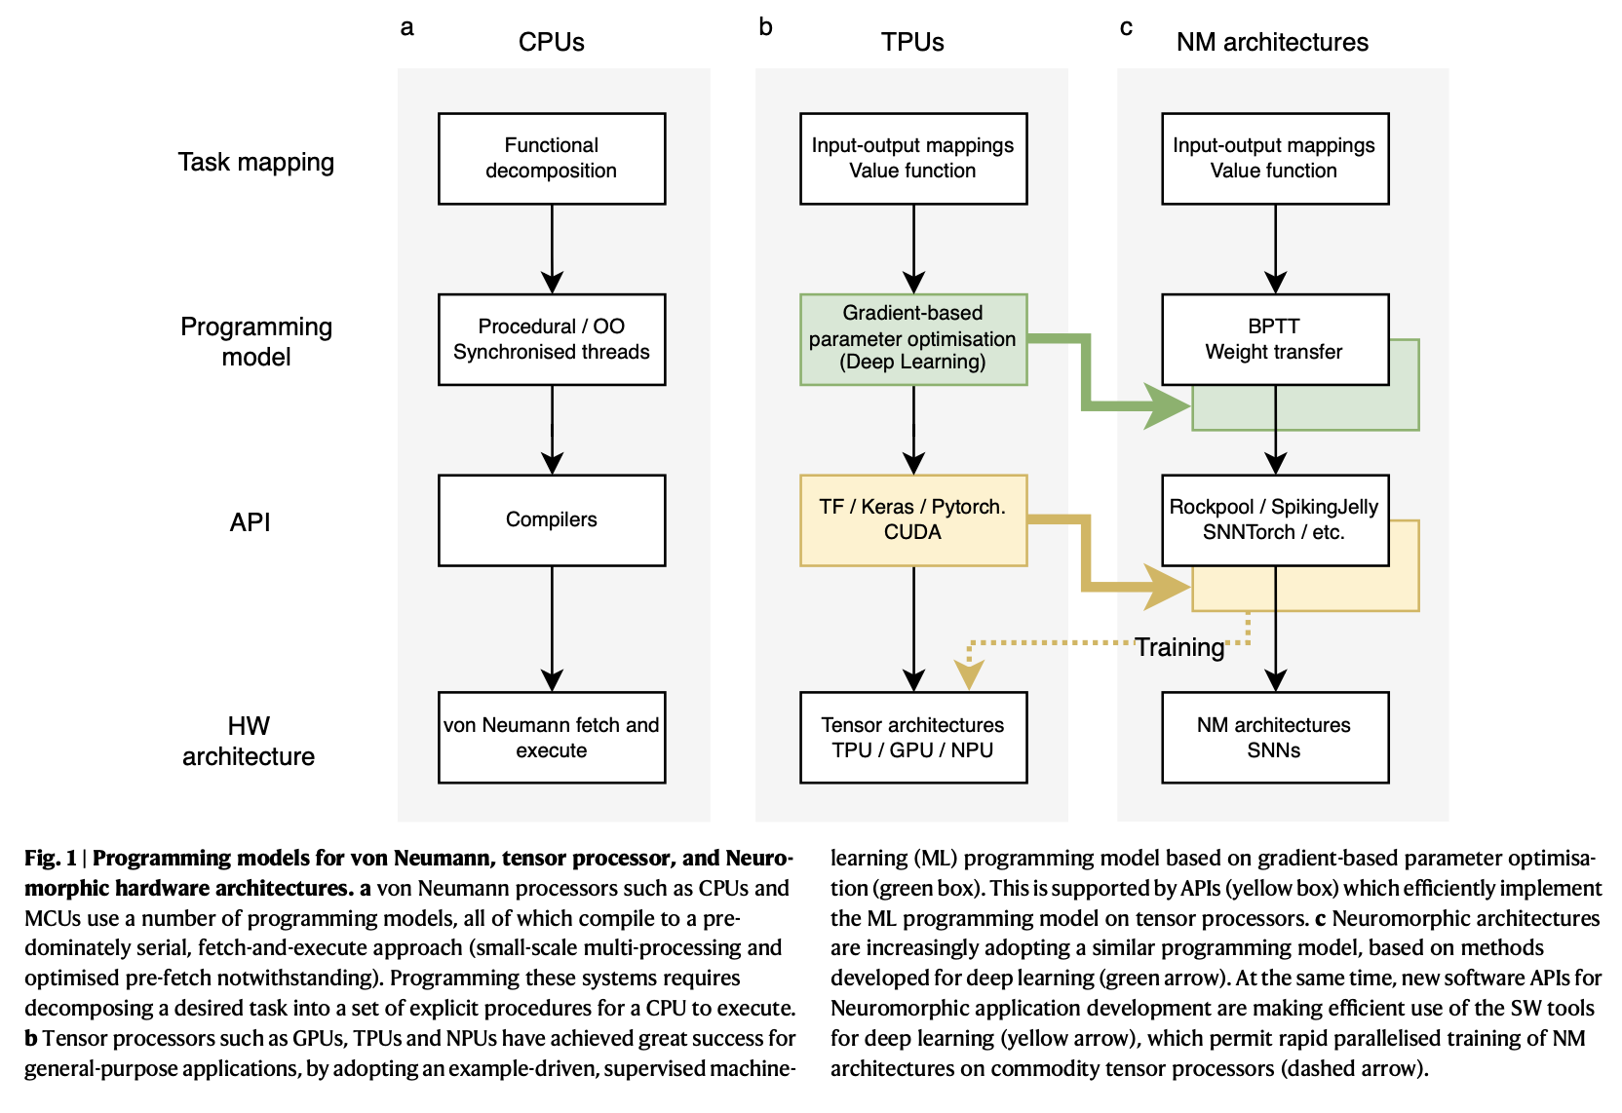
Programming model
Backpropagation through time (BPTT)
https://doi.org/10.1038/s41467-025-57352-1

Slide 29
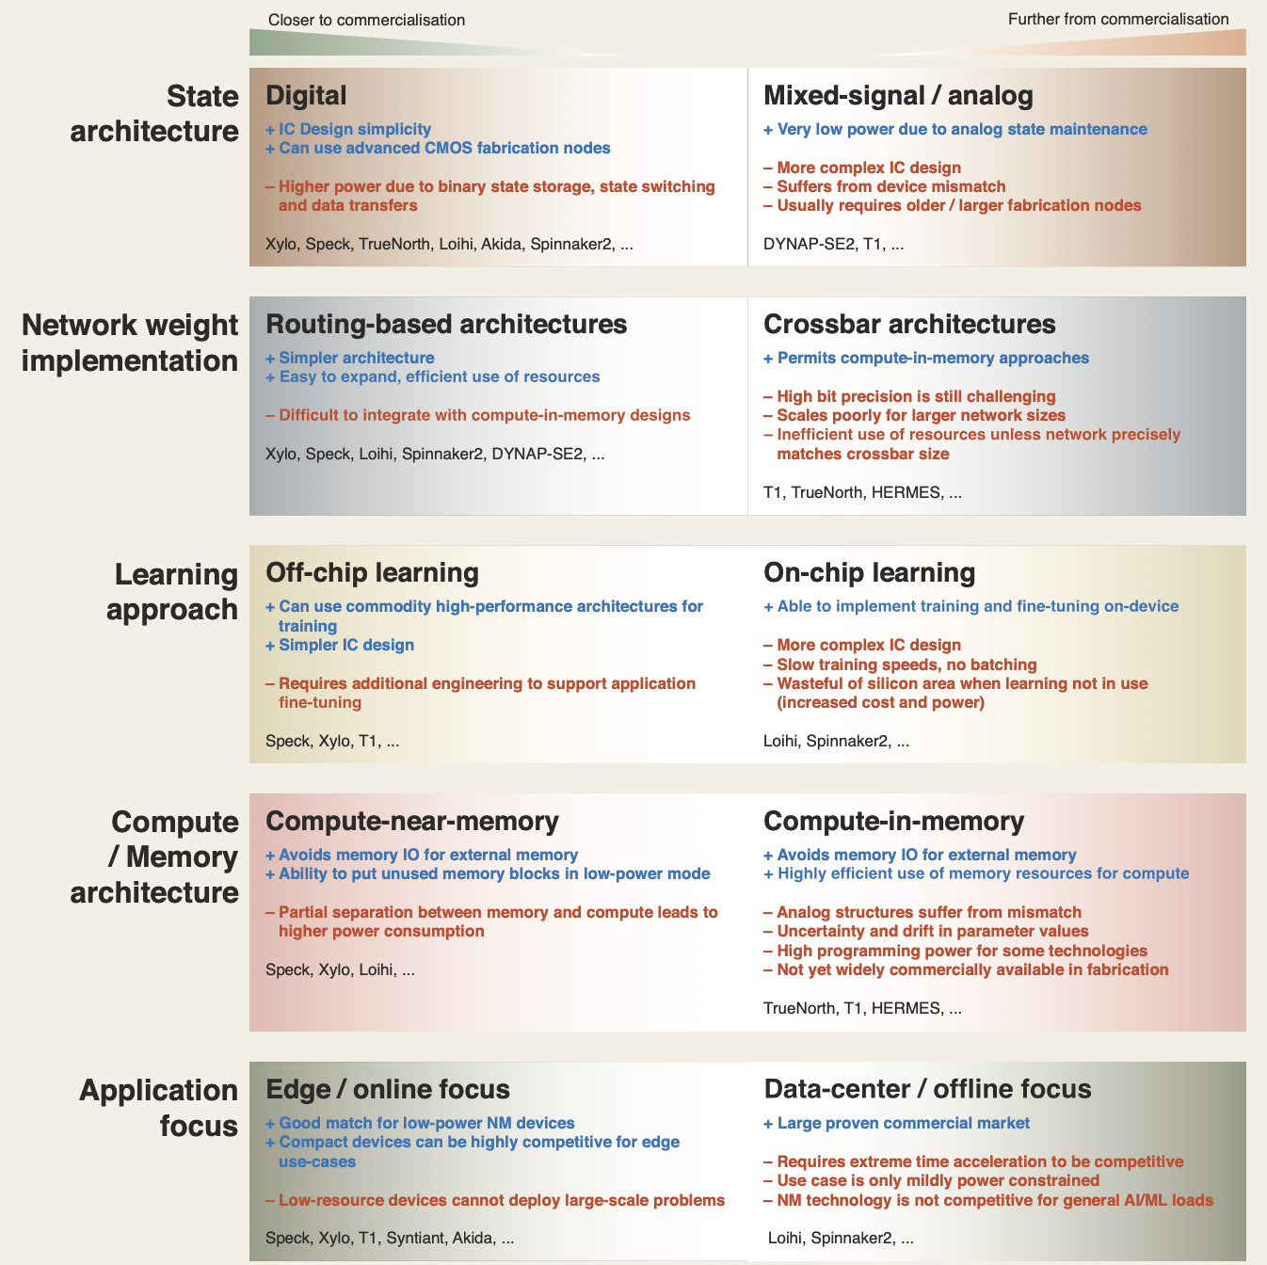
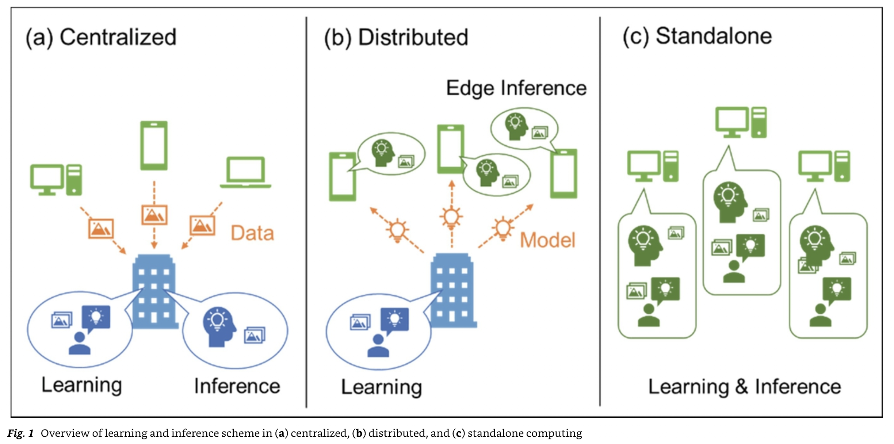
https://doi.org/10.1038/s41467-025-57352-1

Slide 30
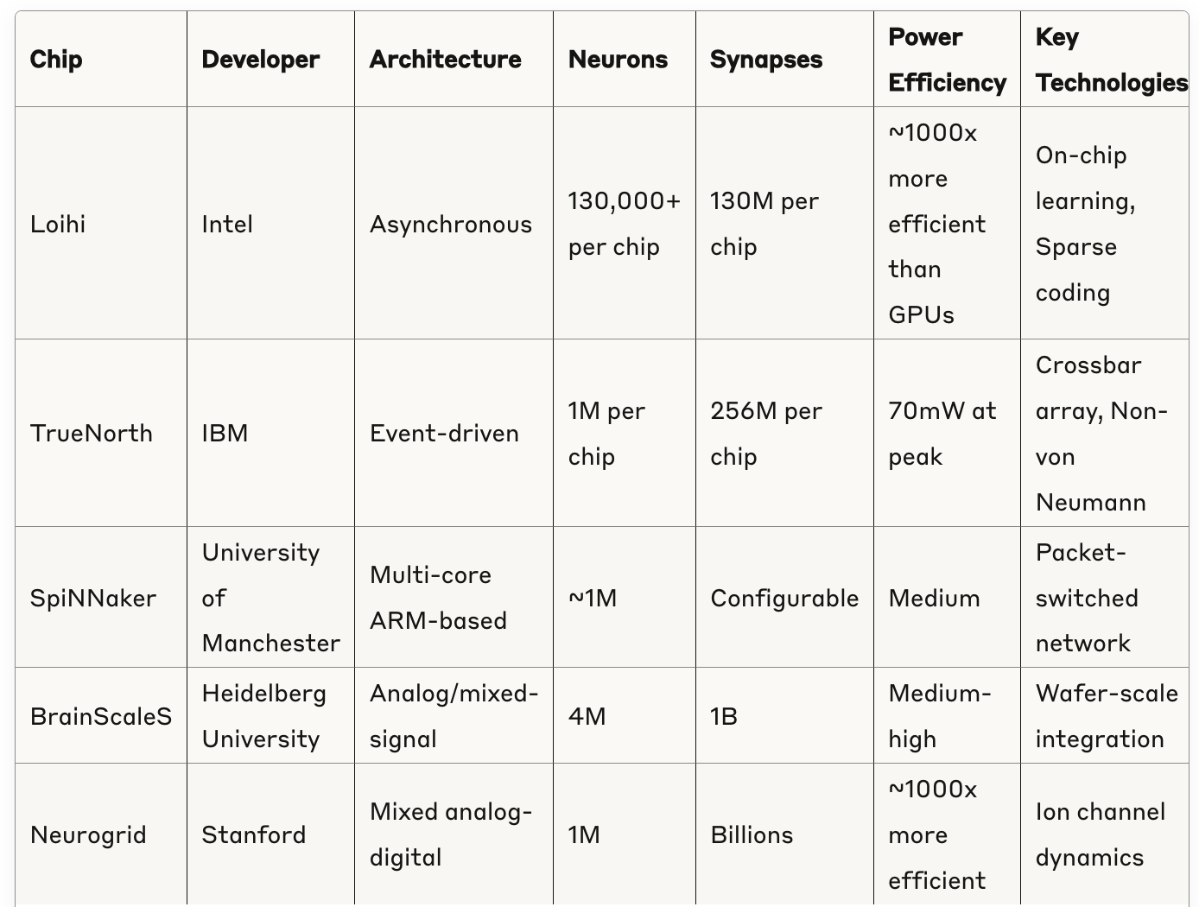
Academic and research chips

Slide 31
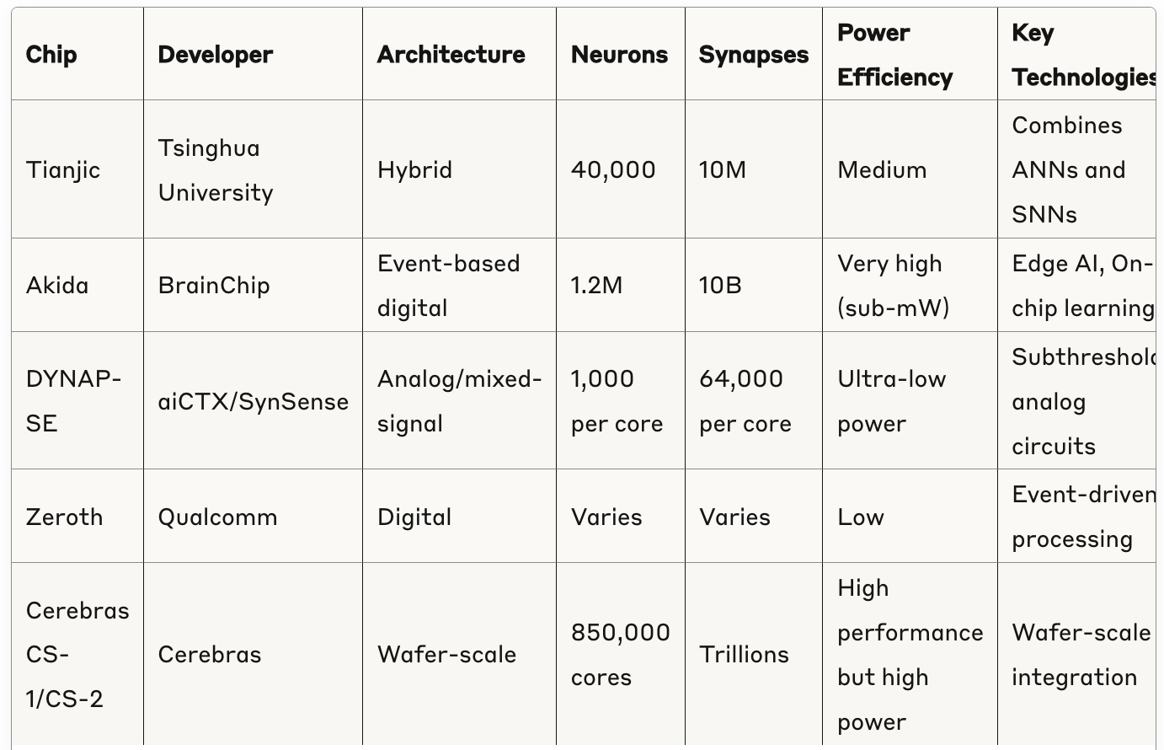
Commercial and emerging neuromorphic chips

Slide 32
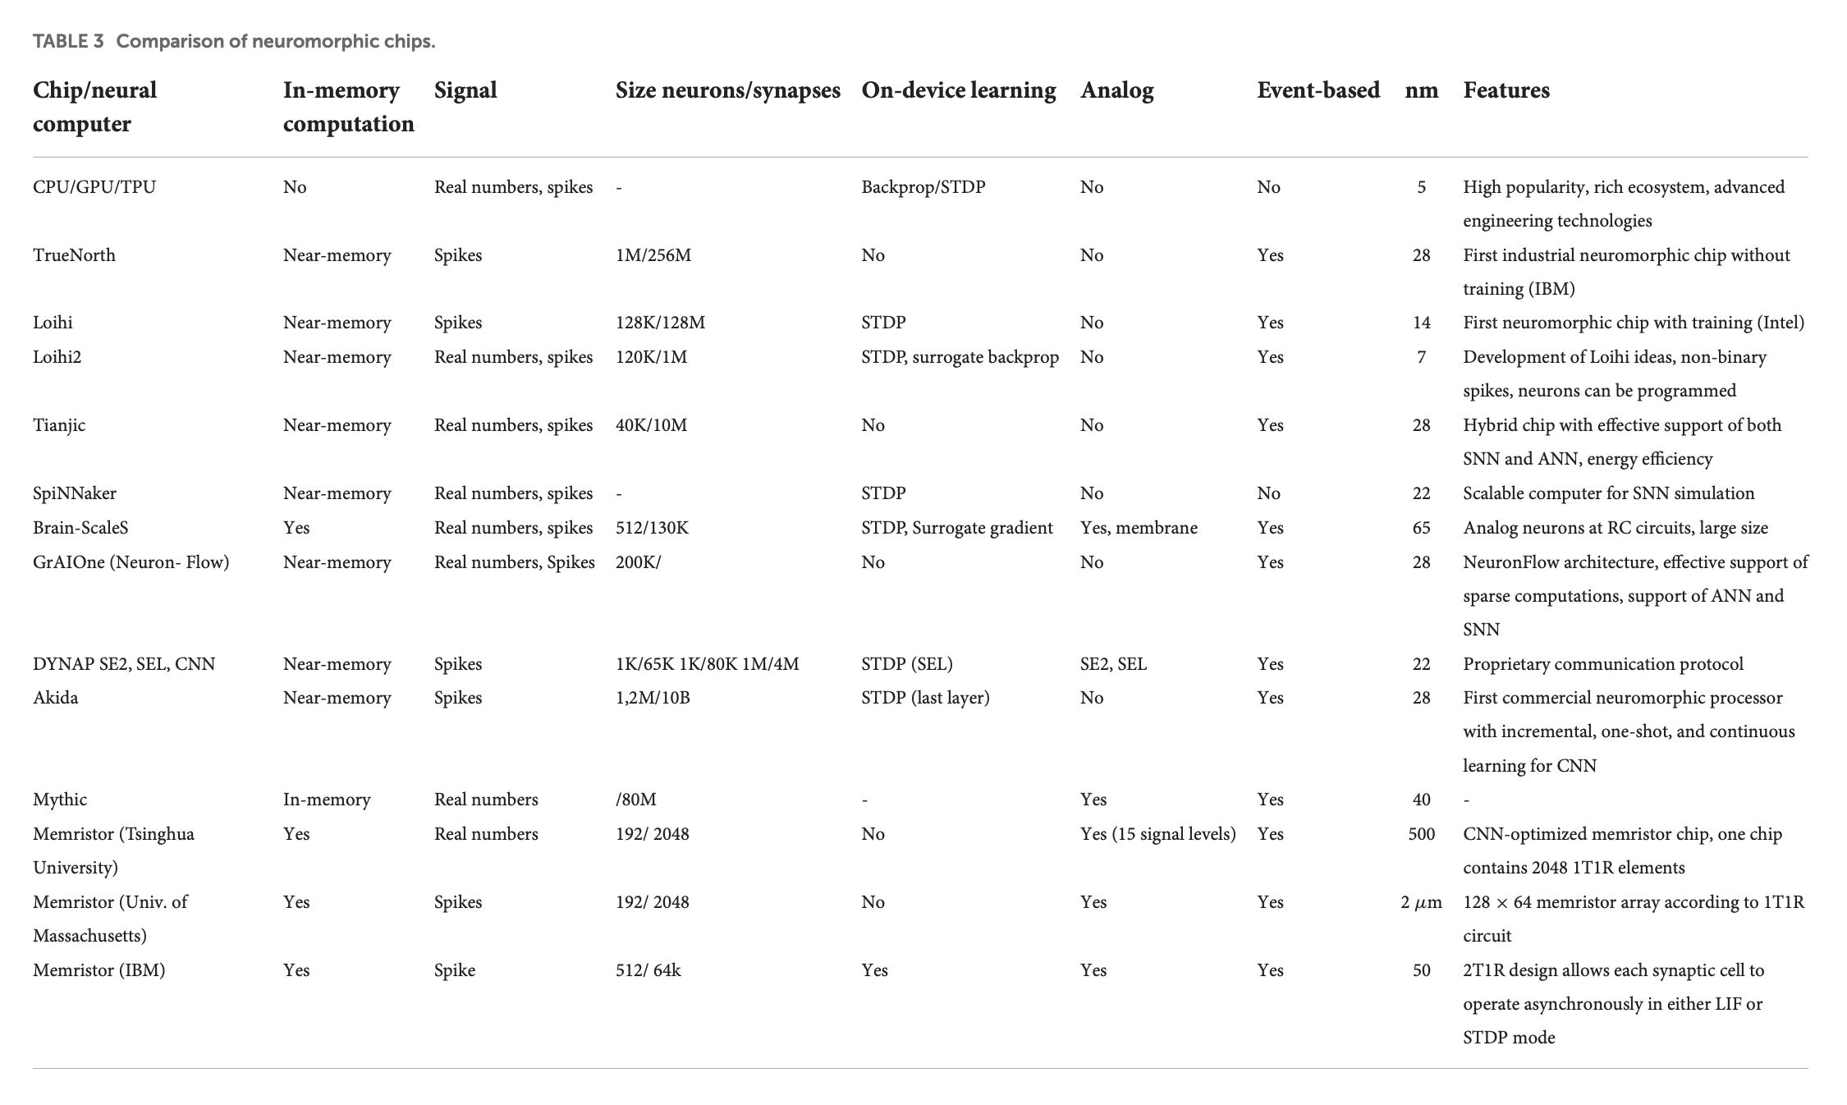
https://doi.org/10.3389/fnins.2022.959626

Slide 33
Current limitations and challenges
Programming Models: Lack of standardized programming frameworks for neuromorphic hardware
Application Development: Limited software ecosystem compared to traditional computing
Scaling: Challenges in scaling to human-brain levels while maintaining efficiency
Algorithm Mapping: Difficulty in mapping existing AI algorithms to neuromorphic architectures
Adoption: Industry adoption still in early stages outside of research applications.
Cost: Silicon cost of large-scale applications is prohibitive. Also: most neuromorphic chips rely on SRAM, which is ~2 orders of magnitude more expensive than DRAM.

Slide 34
Applications
Real-Time Sensing and Processing
Autonomous Vehicles
Edge Computing and IoT
Advanced Robotics
Intelligent Analysis and Security
Cybersecurity
Healthcare Monitoring
Voice and Speech Recognition
Advanced AI Applications
Advanced AI Applications
Efficient Machine Learning
Brain Research
Aerospace and Defense
Autonomous Vehicles
NVIDIA DRIVE AGX provides "a scalable and energy-efficient AI computing platform designed to process the complex workloads required for autonomous driving."
Full Self-Driving (FSD) Computer: Tesla initially used NVIDIA hardware but has since developed its own custom SoC. According to Elon Musk, designing their own chip allows Tesla "to be able to run the neural network at a fundamental, bare metal level" and optimize specifically for their needs. Tesla's FSD computer delivers 144 TOPS while consuming 72 watts of power.
Intel Mobileye EyeQ: BMW, Volkswagen, and Nissan use Mobileye technology.
Qualcomm's Snapdragon Ride: "designed to power all levels of automated driving" with a scalable architecture that can handle everything from basic driver assistance to fully autonomous driving. Volkswagen, BMW, General Motors, and Toyota have partnered with Qualcomm for their autonomous technology

Slide 35
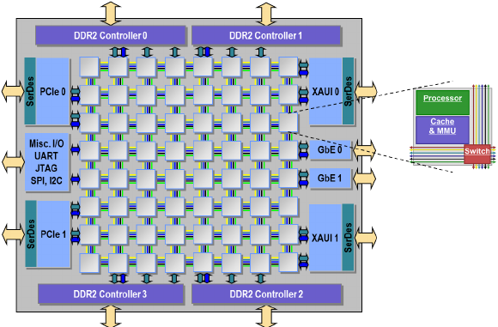
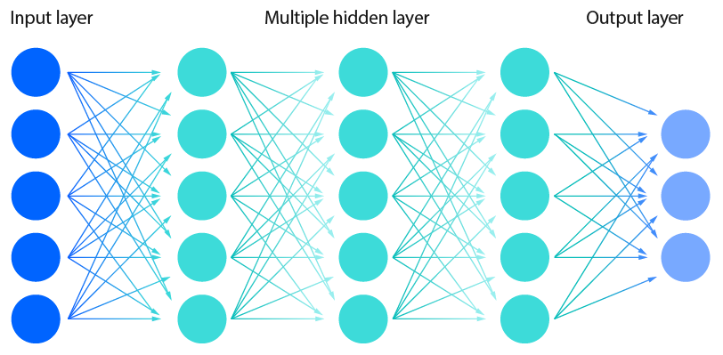
How to communicate spikes?
Map on grid of processors

Slide 36
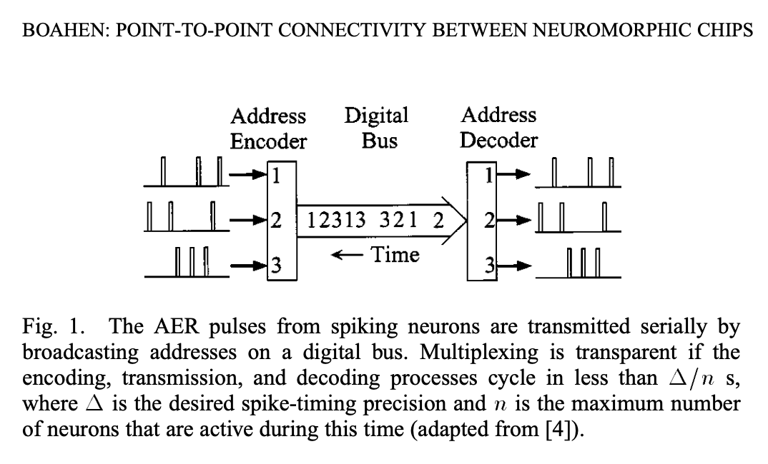
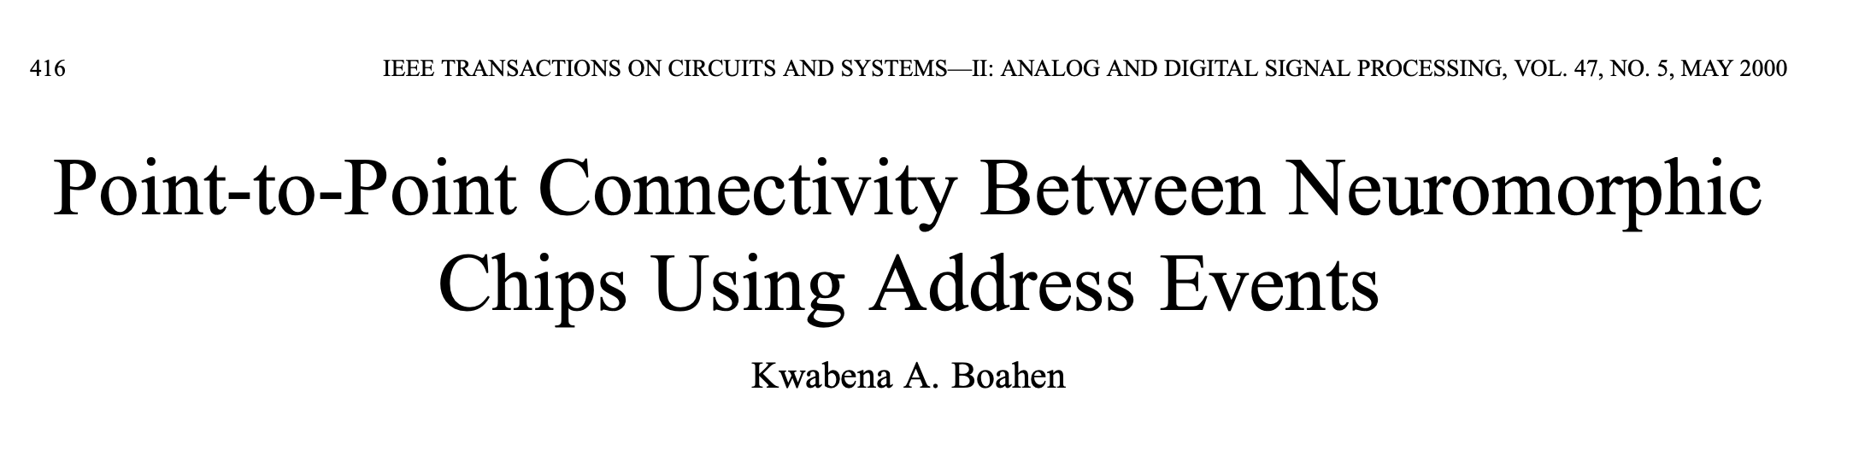
It’s all about AER (Address Event Representation)
Address Event Representation (AER) is a spike event message passing protocol for Network-on-Chip (NoC).
Almost all hardware and software simulation environments use a variant of AER
The simplest and most efficient implementation of AER sends a firing neuron's unique identification number to all of the nodes containing any of that neuron's targets.
Each spike is typically encoded as a packet containing source/destination information
Only active neurons that produce spikes generate messages.
The timing information is implicit in when the message is sent.
Efficient, event-driven communication system.
AER allows for asynchronous, sparse communication between neuromorphic cores
A NoC routes these spike event messages between different neural processing elements.

Slide 37
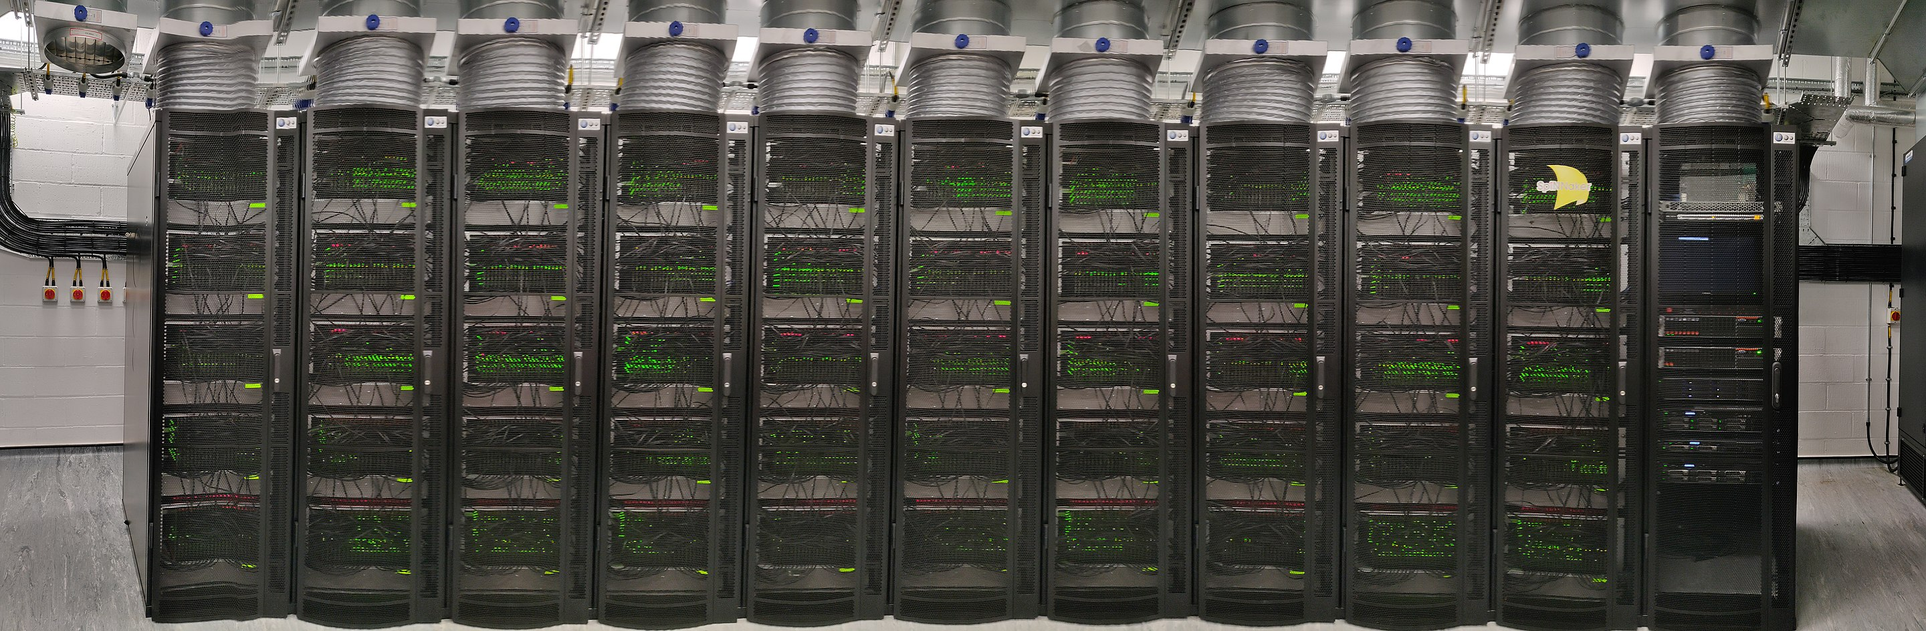
SpiNNaker
SpiNNaker: Contains approximately 1 million ARM9 processor cores across 1,200 boards
SpiNNaker2: Aims for 10 million ARM processor cores, with the current implementation having about 5.2 million cores across 720 boards

Slide 38
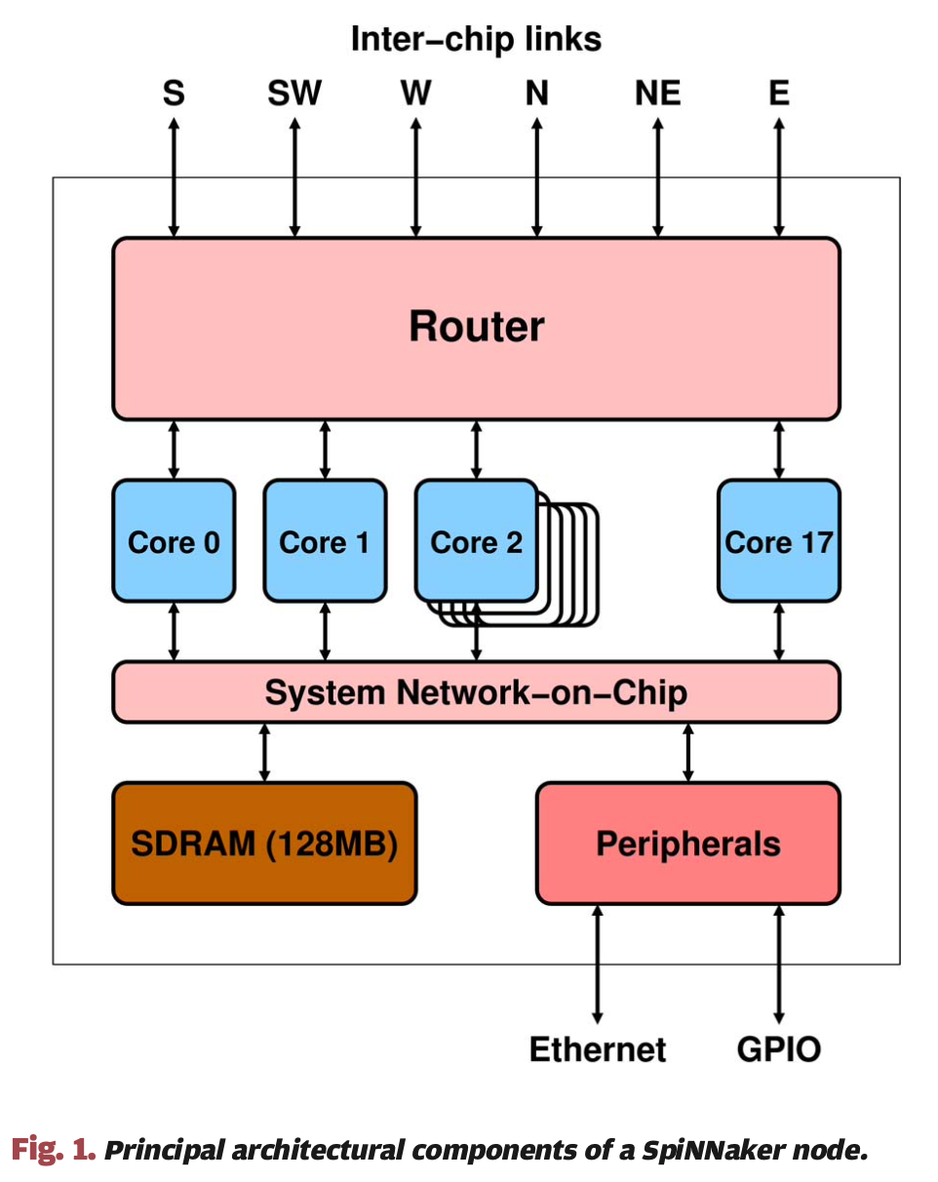
SpiNNaker
The spiking neural network architecture (SpiNNaker) project aims to deliver a massively parallel million-core computer whose interconnect architecture is inspired by the connectivity characteristics of the mammalian brain, and which is suited to the modeling of large-scale spiking neural networks in biological real time.
A SpiNNaker machine is a homogeneous 2D MIMD array of processing nodes. Each node incorporates 18 ARM968 processor cores (1 serves as a spare) each with 96 kB of local memory, 128 MB of shared memory, a packet router, and general system support peripherals.
Each processor core is a general-purpose 200MHz 32-bit integer processor with no floating-point hardware, so arithmetic is generally implemented as fixed point.
DOI: 10.1109/JPROC.2014.2304638

Slide 39
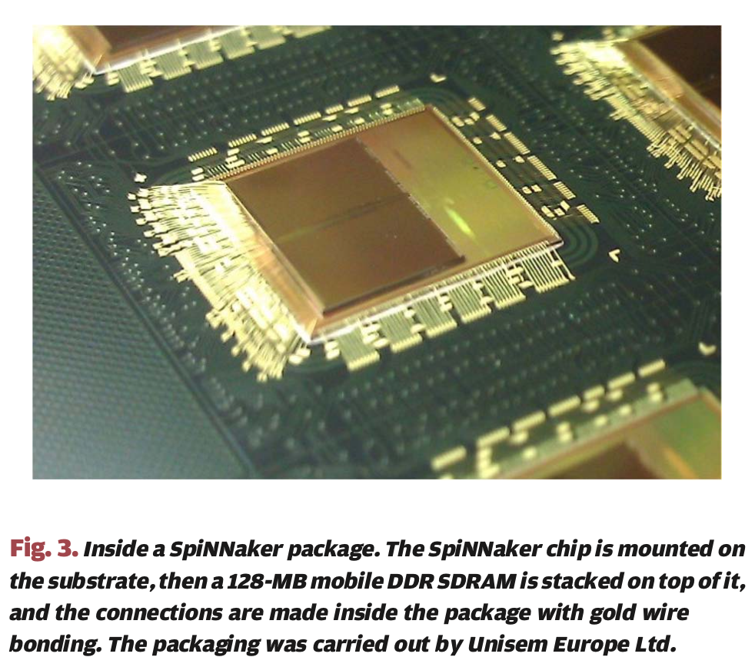
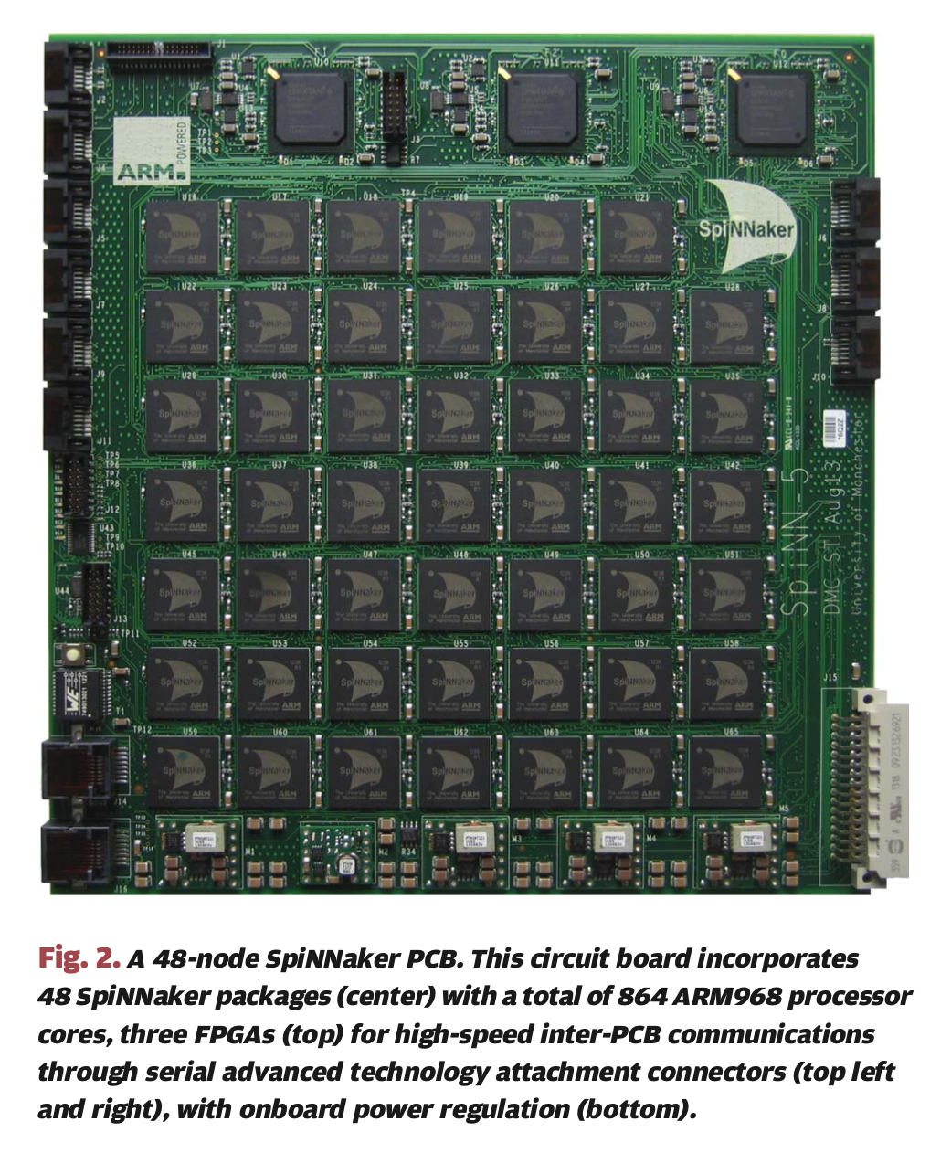
SpiNNaker
DOI: 10.1109/JPROC.2014.2304638

Slide 40
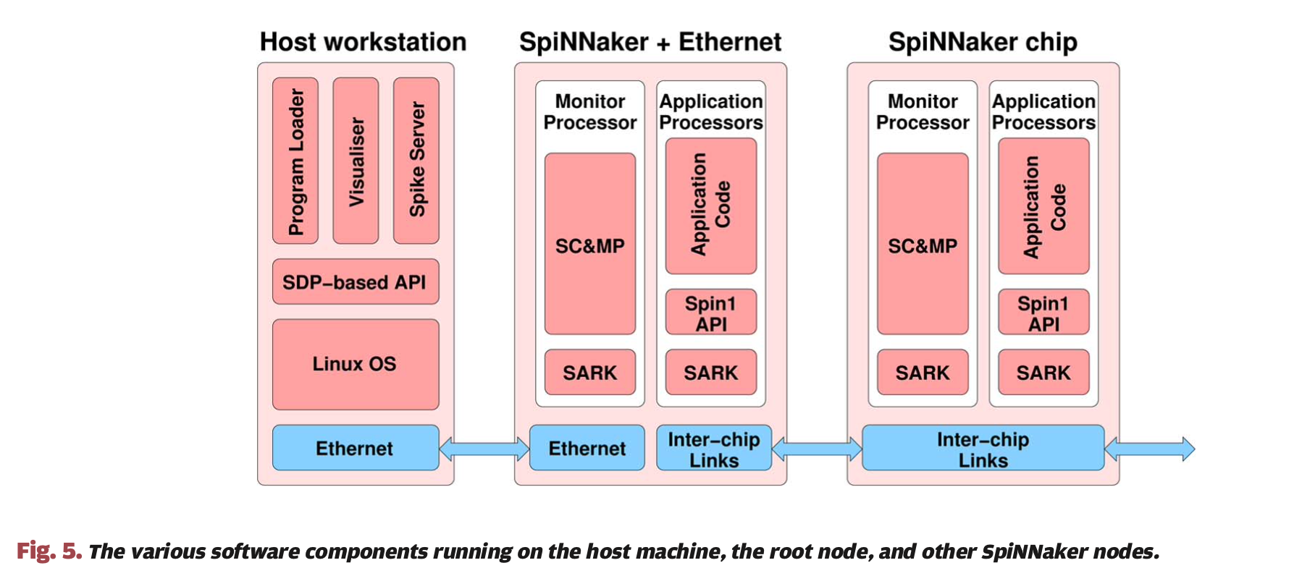
SpiNNaker software
SpiNNaker Control and Monitor Program (SC&MP)
SpiNNaker Application Runtime Kernel (SARK)
The programming model employed on SpiNNaker is that of a real-time event-driven system.
DOI: 10.1109/JPROC.2014.2304638

Slide 41
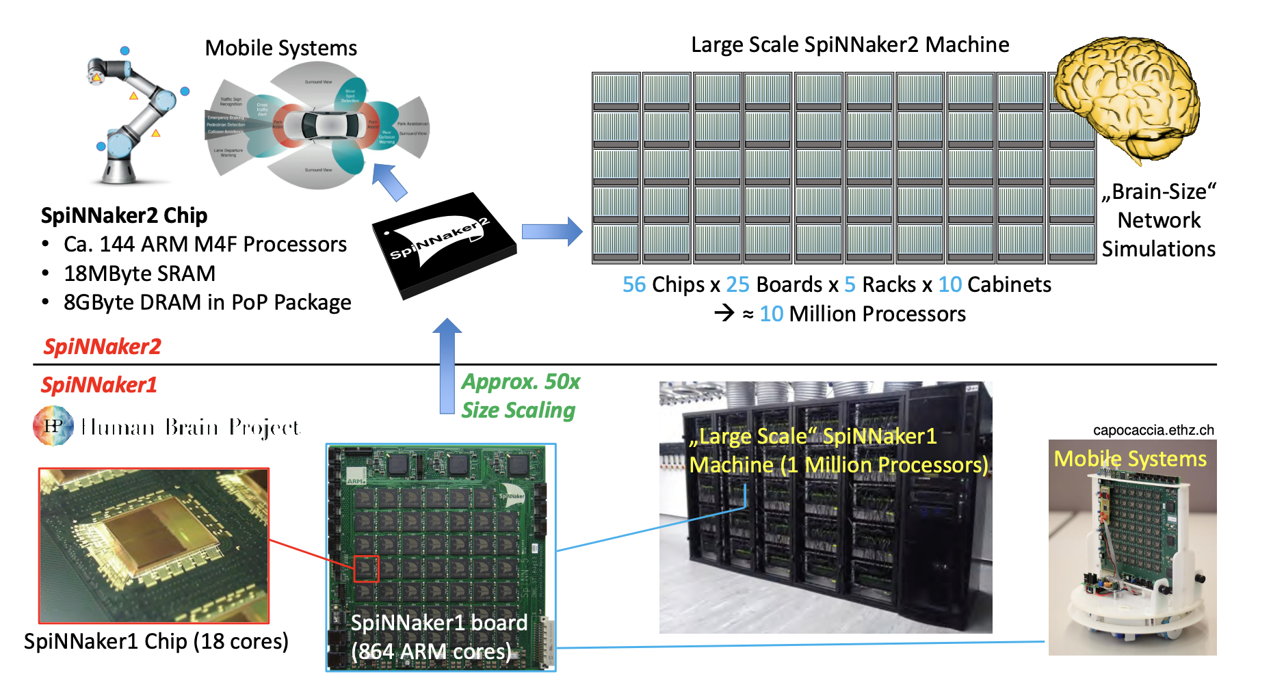
SpiNNaker2
SpiNNaker1: 1 Million core machine in 130nm CMOS
SpiNNaker2: 10 Million core machine in 22nm FDSOI

Slide 42
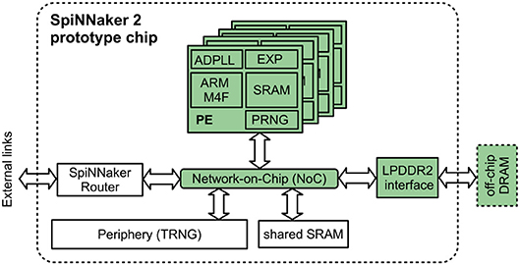
SpiNNaker vs SpiNNaker2
ARM Cortex-M4
ARM9

Slide 43
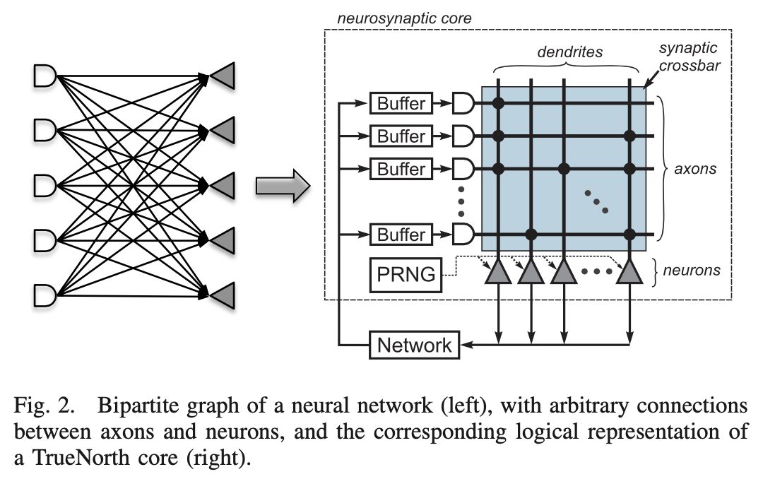
IBM’s TrueNorth
TrueNorth, a 65 mW, 5.4 billion transistor, real-time neurosynaptic processor that implements a non-von Neumann, low-power, highly-parallel, scalable, and defect-tolerant architecture.
With 4096 neurosynaptic cores, the TrueNorth chip contains 1 million digital neurons and 256 million synapses tightly interconnected by an event-driven routing infrastructure.
DOI: 10.1109/TCAD.2015.2474396

Slide 44
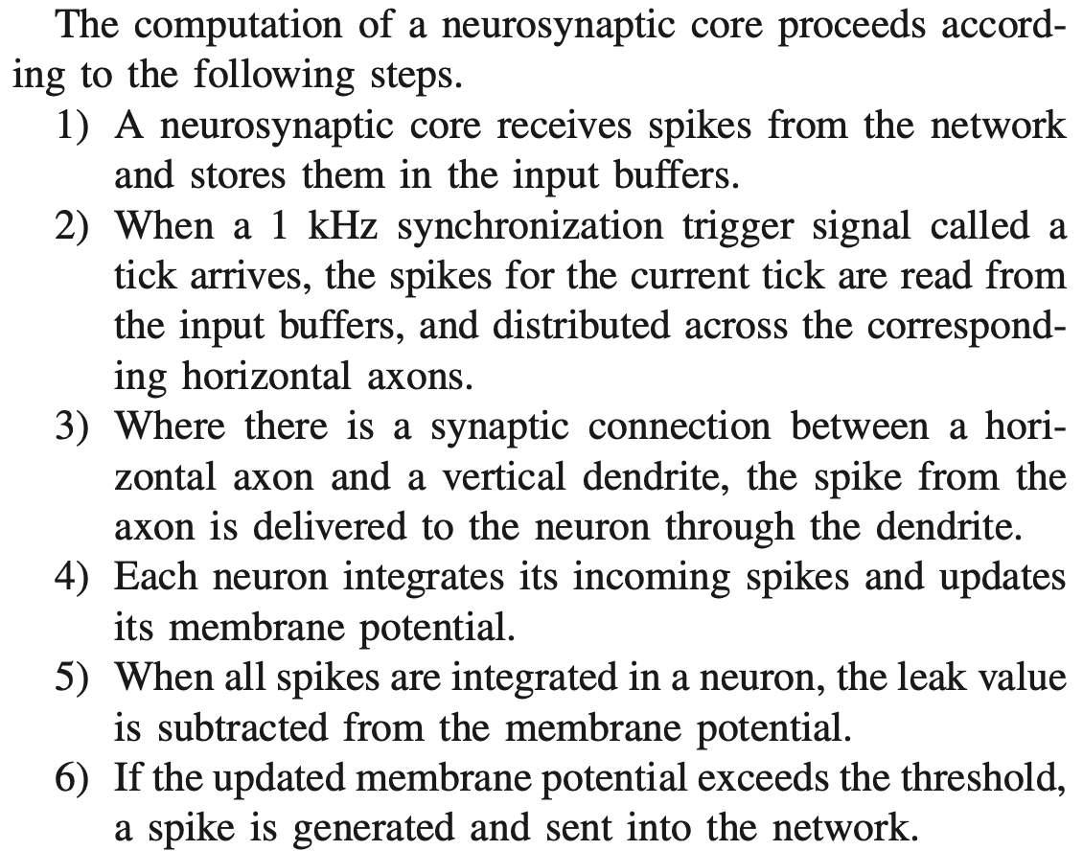
IBM’s TrueNorth
Pseudo random number generator (PRNG) for stochastic spike integration.
DOI: 10.1109/TCAD.2015.2474396

Slide 45
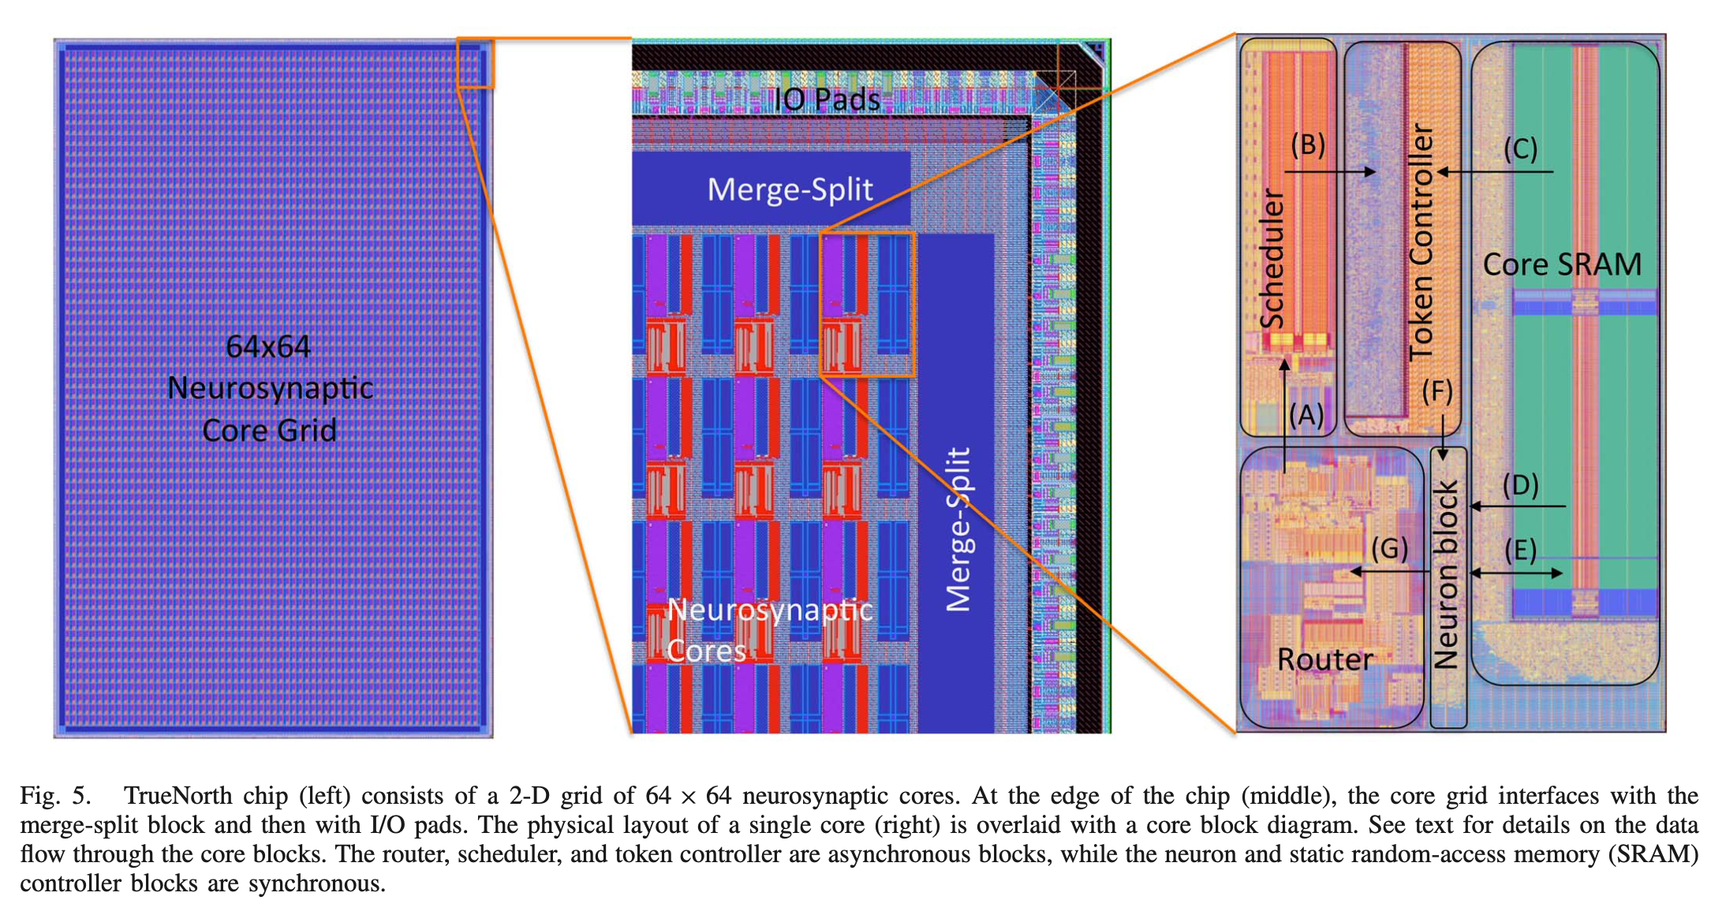
IBM’s TrueNorth chip design
Merge-split blocks at the edges of the chip merge spikes coming from
multiple buses into a single stream of spikes going out of the
chip
DOI: 10.1109/TCAD.2015.2474396

Slide 46



IBM’s TrueNorth
Augmented integrate-and-fire model
2D mesh
6 processes: from local, forward E, forward W, forward N, forward S, to local
5 major elements of the neuron block
Augmented integrate-and-fire model (simpler than HH or Izh)
QDI (Quasi-Delay-Insensitive) async. circuits: handshaking
DOI: 10.1109/TCAD.2015.2474396

Slide 47

IBM’s NorthPole
NorthPole, an architecture and a programming model for neural inference, reimagines the interaction between compute and memory by embodying 10 interrelated, synergistic axioms that build on brain-inspired computing.
Axiom 1: Turning to architecture, NorthPole is specialized for neural inference. For example, it has no data-dependent conditional branching, and it does not support training or scientific computation.
Axiom 2: Inspired by biological precision, NorthPole is optimized for 8-, 4-, and 2-bit low-precision. This is sufficient to achieve state-of-the-art inference accuracy on many neural networks while dispensing with the high-precision required for training.
Axiom 3: NorthPole has a distributed, modular core array (16-by-16), with each core capable of massive parallelism (8192 2-bit operations per cycle) (Fig. 2F). Cortex-like modularity of the tiled core array enables homogeneous scalability in two dimensions and, perhaps, even in three dimensions and is also amenable to heterogeneous chiplet integration.
Fig 2
https://www.science.org/doi/10.1126/science.adh1174

Slide 48

IBM’s NorthPole
Axiom 4: NorthPole distributes memory among cores (Figs. 1B and 2F) and, within a core, not only places memories near compute but also intertwines critical compute with memory (Fig. 2, A and B). The nearness of memory and compute enables each core to exploit data locality for energy efficiency. NorthPole dedicates a large area to on-chip memory that is neither centralized nor organized in a traditional memory hierarchy.
Fig 2
Fig 1
https://www.science.org/doi/10.1126/science.adh1174

Slide 49

IBM’s NorthPole
Axiom 5: NorthPole uses two dense networks-on-chip (NoCs) (20) to interconnect the cores, unifying and integrating the distributed computation and memory (Fig. 2, C and D) that would otherwise be fragmented. These NoCs are inspired by long-distance white-matter and short-distance gray-matter pathways in the brain and by neuroanatomical topological maps found in cortical sensory and motor systems. One gray matter–inspired NoC enables spatial computing between adjacent cores (Fig. 3 and fig. S1). Another white matter–inspired NoC enables neuron activations to be spatially redistributed among all cores.
Fig 3
Fig 2
https://www.science.org/doi/10.1126/science.adh1174

Slide 50
IBM’s NorthPole
Axiom 6: Another two NoCs enable reconfiguring synaptic weights and programs on each core for high-speed operation of compute units (Fig. 2, C and D).
Axiom 7: NorthPole exploits data-independent branching to support a fully pipelined, stall-free, deterministic control operation for high temporal utilization without any memory misses, which are a hallmark of the von Neumann architecture. Lack of memory misses eliminates the need for speculative, nondeterministic execution. Deterministic operation enables a set of eight threads for various compute, memory, and communication operations to be synchronized by construction and to operate at a high utilization.
Fig 2
https://www.science.org/doi/10.1126/science.adh1174

Slide 51

IBM’s NorthPole
Axiom 8: Turning to algorithms and software, co-optimized training algorithms (fig. S3) enable state-of-the-art inference accuracy to be achieved by incorporating low-precision constraints into training.
Axiom 9: Codesigned software (fig. S3) automatically determines an explicit orchestration schedule for computation, memory, and communication to achieve high compute utilization in space and time while ensuring that there are no resource collisions.
Axiom 10: NorthPole employs a usage model that consists of writing an input frame and reading an output frame (Figs. 1D and 3), which enables it to operate independently of the attached general processor.
https://www.science.org/doi/10.1126/science.adh1174

Slide 52

IBM’s NorthPole
Tensor Streaming Processor (TSP)
Intel Xeon: 8270, 9282
https://www.science.org/doi/10.1126/science.adh1174

Slide 53

IBM’s NorthPole
https://www.science.org/doi/10.1126/science.adh1174

Slide 54

BrainScaleS chips
Heidelberg University
Human Brain Project
Analog model of a neuron based on an electrical circuit, leads to inflexibility.
arXiv:2201.11063v2

Slide 55


BrainScaleS-2
PPU = plasticity processing unit
arXiv:2201.11063v2

Slide 56

BrainScaleS-2
A single neuromorphic BrainScaleS-2 core consists of a full-custom analog core combining a synaptic crossbar, neuron circuits, analog parameter storage, two digital control- and plasticity-processors, and the event routing network responsible for spike communication.
The physical design is divided into four quadrants, each featuring a synaptic crossbar with 256 rows and 128 columns. The neuron circuitry is also partitioned in this way, with each of the 512 neuron circuits associated with one column.
arXiv:2201.11063v2

Slide 57
BrainScaleS-2
Conceptual view of the system architecture in spike processing mode: Event packets (red dot) get injected by the synapse driver into the synaptic crossbar, where they cause synaptic input integration to occur in synapses with matching addresses (indicated by red lines). Membrane voltage accumulation eventually results in spike generation in the associated neuron circuits. The resulting spikes are routable to both synapse drivers or external output. The plasticity processing unit has low latency and massively parallel access to synaptic weights, addresses, correlation measurements, and neuron membrane voltage dynamics during operation. Plasticity rules and other learning algorithms can use these observables to modify all parameters determining network emulation in an online fashion.
arXiv:2201.11063v2

Slide 58

Loihi
Loihi is a 60-mm2 chip fabricated in Intel’s 14-nm process that advances the state-of-the-art modeling of spiking neural networks in silicon.
Fully digital, but asynchronous
An unambiguous example of spike-based computation, outperforming all known conventional solutions.
Excellent energy efficiency arises from the architecture’s sparse activation with tightly spatially scoped communication. With its specialized asynchronous implementation, Loihi can update many millions of such neurons in microseconds, allowing it to propagate critical events, such as the spike shown in Fig. 1, in a fraction of the time a conventional CPU needs to sequentially inspect and update just one iteration of neural state variables in memory.
M. Davis, Lessons from Loihi: Progress in Neuromorphic Computing

Slide 59

Loihi
However: neuromorphic HW is not in general competitive with general AI/ML workloads.
M. Davis, Lessons from Loihi: Progress in Neuromorphic Computing

Slide 60
Loihi computational primitives
Loihi includes several computational primitives related to other active areas of SNN algorithmic research:
Stochastic noise. Uniformly distributed pseudorandom numbers might be added to a neuron’s synaptic response current, membrane voltage, and refractory delay. This provides support for algorithms such as Neural Sampling,9 which can solve probabilistic inference and constraint satisfaction problems using stochastic dynamics and a form of Markov chain Monte Carlo sampling.
Configurable and adaptable synaptic, axon, and refractory delays. This provides sup- port for novel forms of temporal computation such as polychronous dynamics,10 in which subsets of neurons might synchronize over periods of varying timescales. The number of polychronous groups far exceeds the number of stable attractors in conventional attractor networks, suggesting a productive space for computational development.
Configurable dendritic tree processing. Neurons in the SNN might be decomposed into a tree of compartment units, with the neuron’s input synapses distributed over those compartments. Each compartment supports the same state variables as a neuron, but only the root of the tree (soma compartment) generates spike outputs. The compartments’ state variables are combined in a configurable manner by programming different join functions for each compartment junction.
Neuron threshold adaptation in support of intrinsic excitability homeostasis.
Scaling and saturation of synaptic weights in support of “permanence” levels that exceed the range of weights used during inference.
DOI: 10.1109/MM.2018.112130359

Slide 61

Loihi
Reconfigurable learning engine
DOI: 10.1109/MM.2018.112130359

Slide 62


Loihi
Blabla
DOI: 10.1109/MM.2018.112130359

Slide 63




Slide 64

Loihi 2 + Hala Point
https://www.youtube.com/watch?v=CPuaud9xi3U

Slide 65




Loihi 2
DOI 10.1109/SiPS52927.2021.00053

Slide 66


LLM on Loihi 2
Why is that gain performance not impressive?
arXiv:2503.18002v2

Slide 67

Akida
Akida (Vanarse et al., 2019) is the first commercial neuromorphic processor, commercially available since August 2021.
BrainChip's Akida is an ultra-low-power neuromorphic processor inspired by the brain’s neural architecture. It accelerates complex AI at the edge through event-based processing, on-chip learning abilities, and support form advanced neural networks like CNNs, RNNs & custom Temporal Event-based Nets.
Temporal Event-based Neural Networks (TENNs), which combine spatial and temporal convolutions to efficiently process sequential spatiotemporal data.
Akida’s ecosystem provides a free chip emulator, TensorFlow compatible framework MetaTF for the transformation of convolutional and fully connected neural networks into SNN, and a set of pre-trained models.

Slide 68

Do we need brain-like HW?
“Although efforts to address neuromorphic solutions through hardware based on top-down CMOS-based technologies have obtained interesting results in terms of energetic efficiency
improvement, the replication of brain’s self-assembled and redundant architectures
is not considered in the roadmaps of data processing electronics.”
DOI: 10.3389/fnins.2024.1465789

Slide 69

https://doi.org/10.1038/s41467-025-57352-1

Slide 70


https://doi.org/10.1038/s41586-024-08253-8

Slide 71

Progression of neuromorphic computing systems
https://doi.org/10.1038/s41586-024-08253-8

Slide 72

Feature maturation of neuromorphic computing
https://doi.org/10.1038/s41586-024-08253-8

Slide 73

Gaps in neuromorphic computing
https://doi.org/10.1038/s41586-024-08253-8

